Slide 1
CAROTENOIDS ANTIOXIDANT MECHANISM & BIOAVAILABILITY
Presented By :- Sangeeta Balyan
MS Food Science & Technology

Slide 2
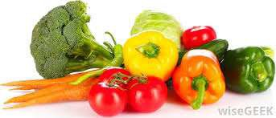
Introduction
Carotenoids are organic pigments that are produced by plants, algae, and some species of bacteria and are responsible for many of the red, orange, and yellow colors of fruits, flowers, and plant leaves. They are among the most common natural pigments, with over 600 different compounds characterized
Carotenoids are the precursor of Vitamin A & are powerful antioxidants that
helps in preventing some form of cancer and heart disease.
Carotenoids are produced from fats & other basic organic metabolic building blocks found in Plants & Photosynthetic bacteria.
Major food sources are Carrots, Sweet Potato, Dark leafy greens especially broccoli & spinach , Tomato, Pumpkin, Palm oil & fruits like apricot, Papaya & Mango.
Most Carotenoids are oil soluble.

Slide 3
Carotenoids Chemistry
Carotenoids are a class of hydrocarbon compounds consisting of 40 carbon atoms (tetraterpenes), with a structure characterized by an extensive conjugated double- bond system that determines the color (it serves as a light-absorbing chromophore)As the number of conjugated double-bond increases, color changes from pale yellow, to orange, to red.
Carotenoids are usually lipophilic due to the presence of long unsaturated aliphatic chains as in some fatty acids.
The general structure of the carotenoid is a polyene chain consisting of double bonds and possibly terminating in rings.
This structure of conjugated double bonds leads to a high reducing potential, or the ability to transfer electrons throughout the molecule

Slide 4
Classification of Carotenoids
CAROTENES
Oxygen free Carotenoids which contains only carbon & Hydrogen.
Readily soluble in petroleum Ether & hexane.
Found in carrots, Apricots & gives bright orange colour.
E.g Lycopene, β Carotene
XANTHOPHYLLS
Contains 1 or more O2 atoms and functions like hydroxy, epoxy, keto, carboxy and methoxy groups.
Dissolve best in Methanol & Ethanol.
Generally yellow in colour.
E.g Lutein, Zeaxanthin

Slide 5
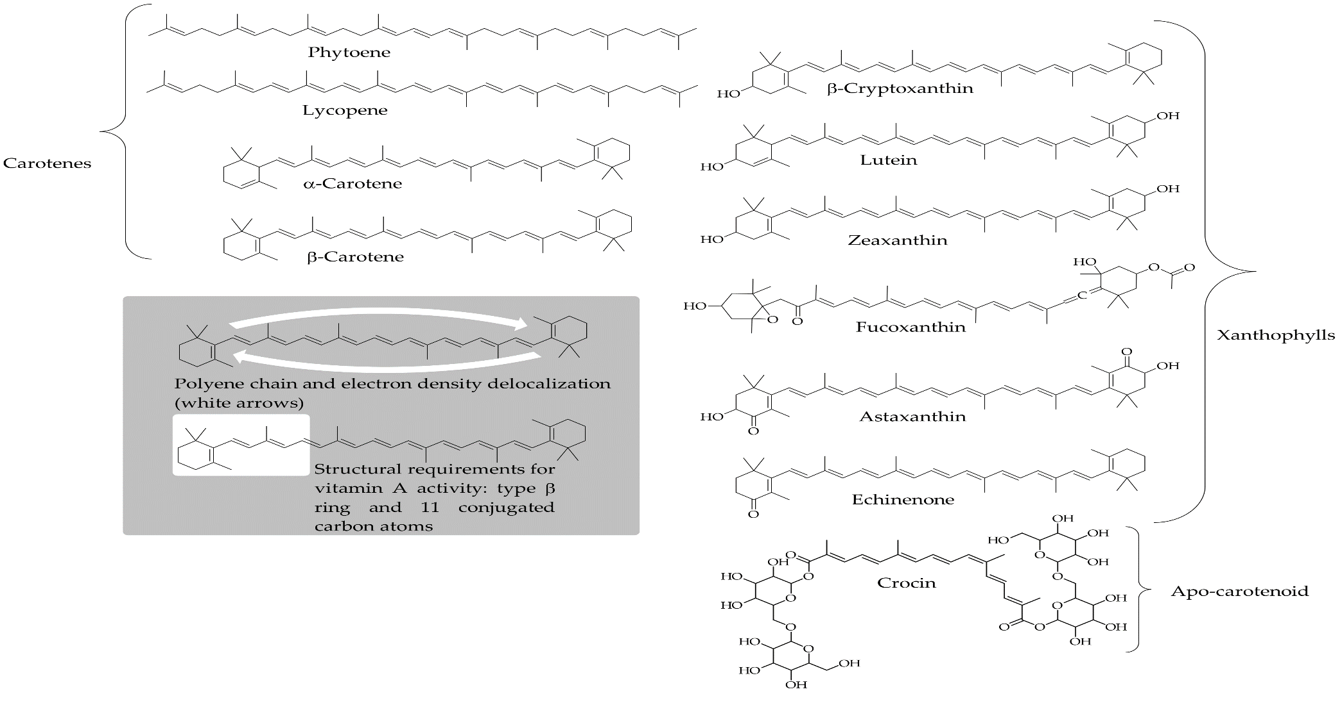
Structures of common Carotenoids

Slide 6
Quench singlet electron
Easily isomerizes & oxidized
Properties of carotenoids
Lipophilic, insoluble in water
Bind to hydrophobic surfaces

Slide 7
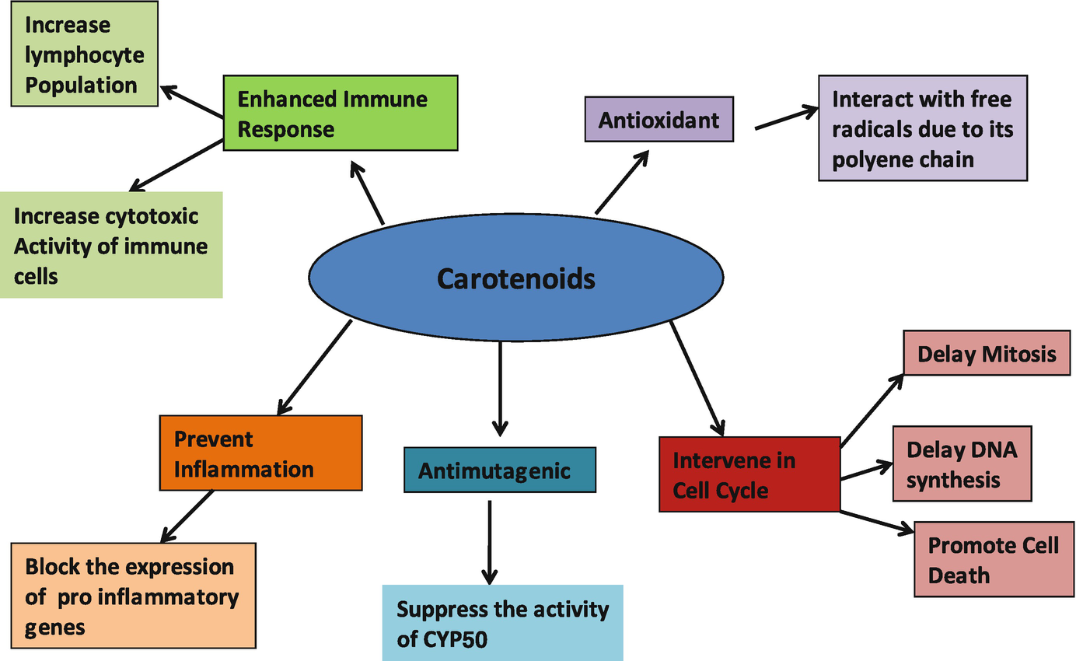
Mechanism of action of carotenoids

Slide 8
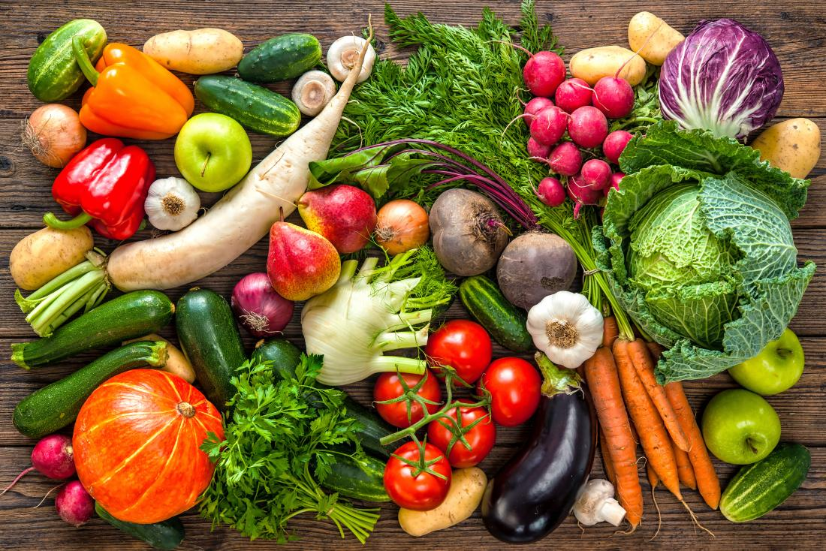
What are Antioxidants ?
Antioxidants are substances that can prevent or slow damage to cells caused by free radicals, unstable molecules that the body produces as a reaction to environmental and other pressures

Slide 9
Carotenoids as Antioxidant
Carotenoids are one of the major groups of antioxidants found in fruits and vegetables. The polyene chain is the structural feature that determines the chemical reactivity of carotenoids toward free radicals, then its antioxidant properties.
The “core” structural element of carotenoids is a polyene backbone consisting of a series of conjugated C=C bonds. This feature is primarily responsible for both their pigmenting properties and the ability of many of these compounds to interact with free radicals and singlet oxygen and therefore act as effective antioxidants.

Slide 10
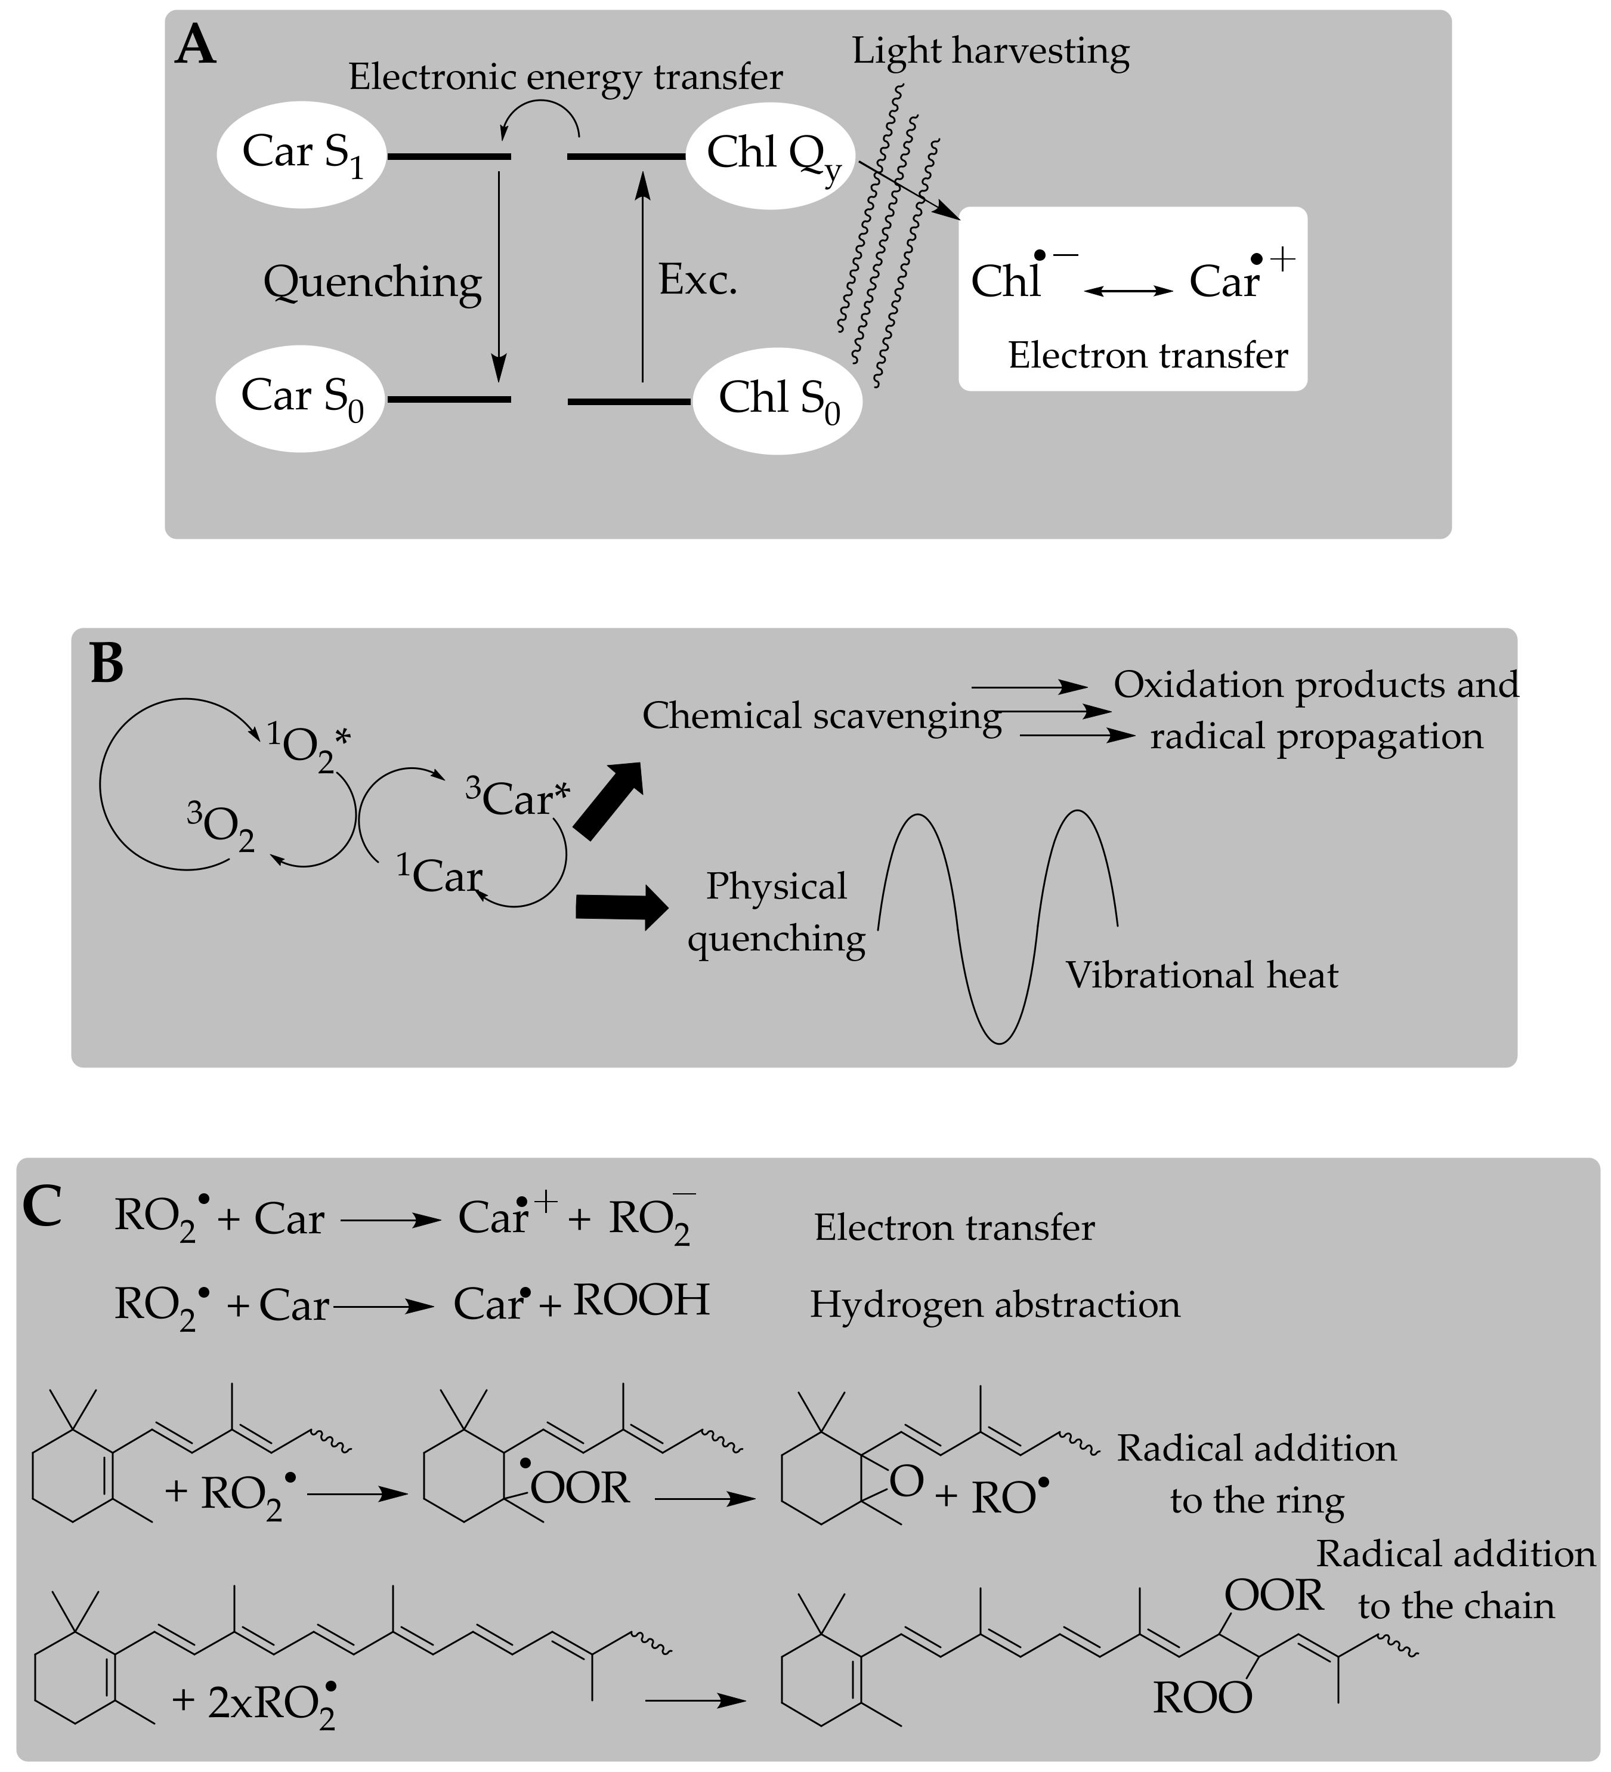
Mechanisms of the antioxidant action exerted by carotenoid pigments in different processes.
A). The electron transfer from the characteristic conjugated polyenoic chain of carotenoids to chlorophylls
B). Physical quenching of singlet oxygen
C). Electron transfer, hydrogen abstraction, and radical addition in the antioxidant activity against peroxyl radicals
( Galvez et al,2020)

Slide 11
Bio accessibility & Bioavailability and in Human Body
“Bio accessibility” is a digestive process to release carotenoids from the food matrix and consider being most crucial step to support carotenoids bioavailability at enterocyte levels.
Bioavailability is defined as “the fraction of an ingested nutrient that is available for utilization in normal physiological functions or for storage”.
Bio efficacy is the efficiency of ingested carotenoids that are made available as such or converted to active form of metabolite for executing desired function in the body
There is several factors that influence Crts bioavailability, absorption, breakdown, transport and storage,Carotenoids are lipids soluble, its bioavailability is extremely low, further it may interfere with various dietary and physiological factors

Slide 12
Effects of Processing & Cooking
Dehydration
Dehydration results in severe degradation & isomerisation of Carotenoids specially if the dried vegetables are kept unprotected from light & Air.
Discoloration of Dried vegetable is promoted by high temperature.

Slide 13
Losses incurred during STORAGE
Storage at 7-20°C for 16-43 days causes a substantial decrease in total carotenoid content even when fruits are ripened at optimal temperatures.
Losses in α, β carotene and lutein increases in carrots as storage temp increases above 4°C.
Both sweet pepper and parsley loose over 20% of their total carotenoid content at cold room storage (7°C) for 9 days.
Indian Tuber shows irregular behaviour as its Carotenoids content increases with storage at 4°C & 25-30°C but decreases with 15- 20°C.

Slide 14
THANK YOU

Slide 15
QUESTIONS ?

