Slide 1
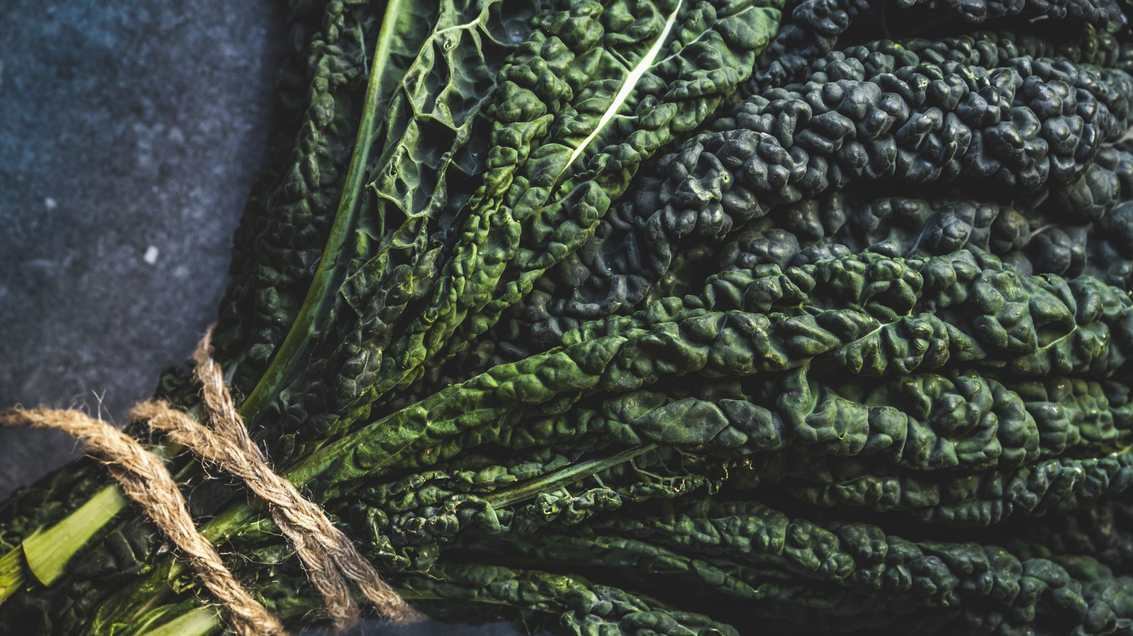
Can We Breed Plants For More Antioxidants?
Samikshya Bhattarai

Slide 2
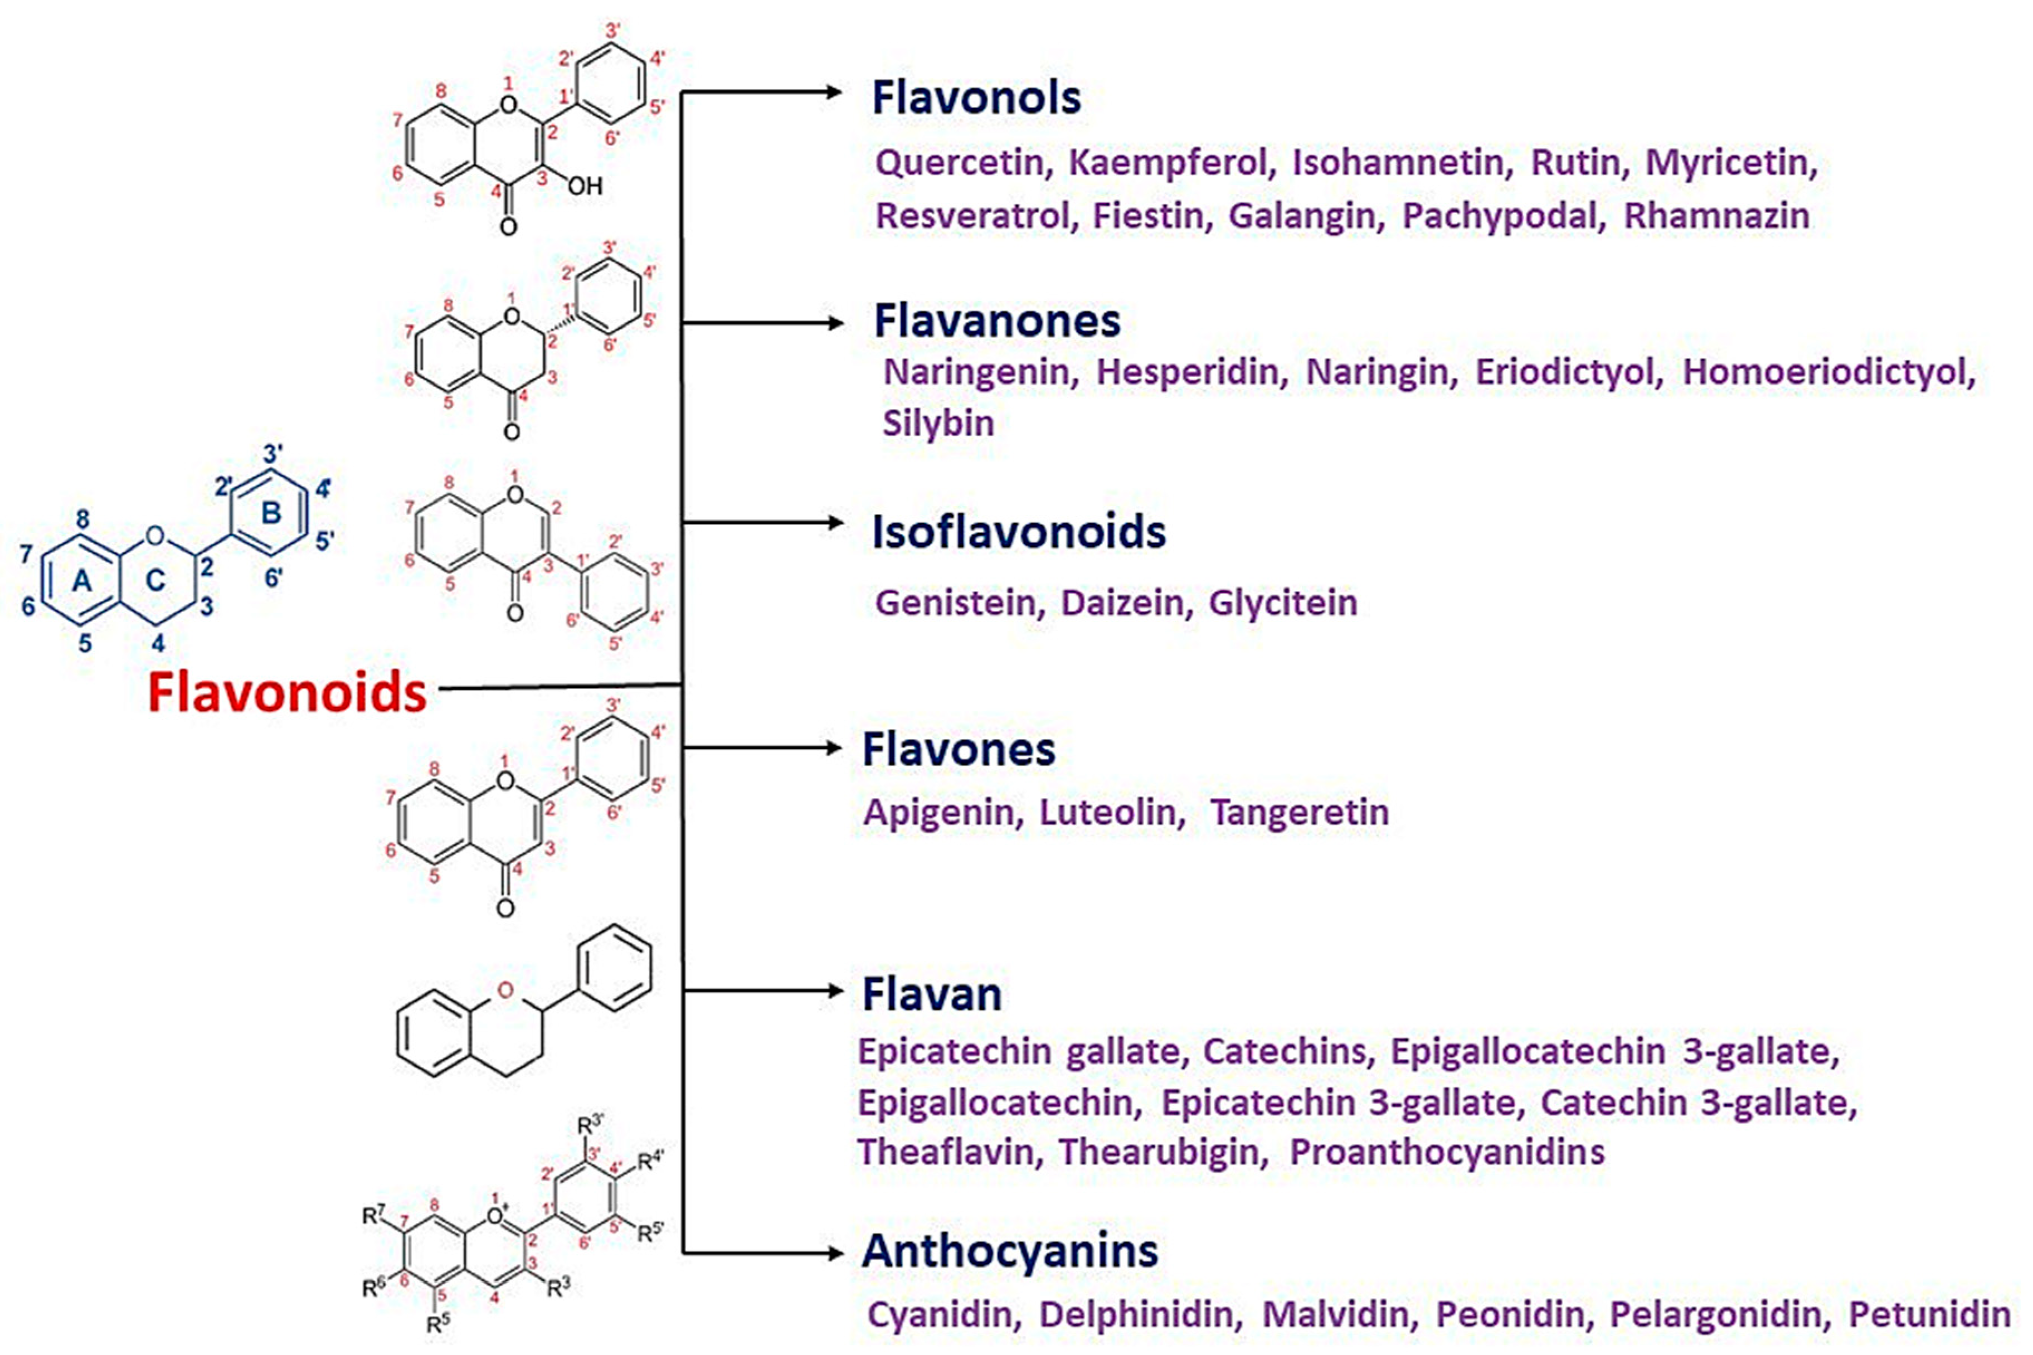
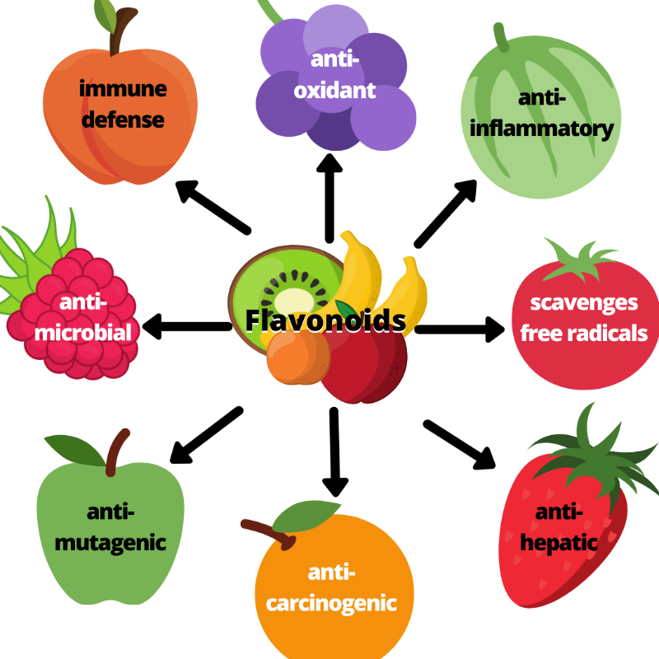
The Antioxidant Properties of Plant Flavonoids: Their Exploitation by Molecular Plant Breeding (D’Amelia et al., 2018)
(Aboody et al., 2020)

Slide 3
(Bernatoniene and Kopustinskiene, 2018)

Slide 4
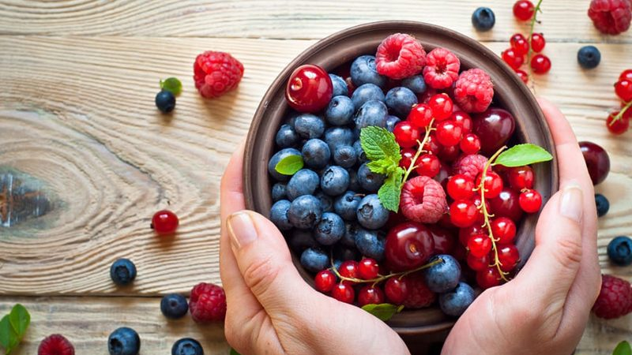
Molecular Breeding and Biotechnological Approaches to Study and Exploit Plant Flavonoids

Slide 5
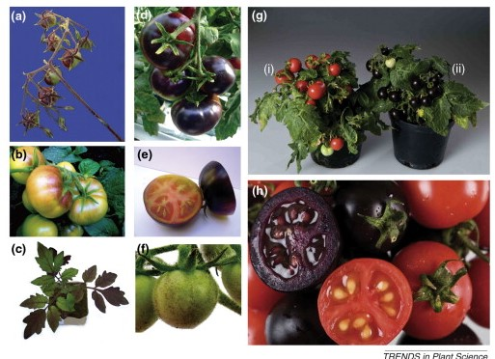
Classical Breeding Methods
(b) Solanum lycopersicum fruit with the Aft (Anthocyanin fruit) gene
(c) S. lycopersicum plant with the atv (Atroviolacium) gene
(d,e) S. lycopersicum fruit with both the Aft and atv genes (Aft × atv plants)
(Gonzali et al., 2009)

Slide 6
Allium ursinum or A. victoralis (containing novel flavonoids) × A. sativum
“Morado” : open-pollinated varieties of maize with high anthocyanin and other flavonoids
Used as parent to introgress “strong” alleles of anthocyanin regulatory genes in European or North American varieties
Potato cultivars, “Negra” and “Challina” suggested to be used for varietal development in relation to enhancing anthocyanin through introgressive hybridization
Rice: subspecies indica and japonica- rich sources of flavonoids
Challenges:
polygenic traits
Genotype × Environment interactions

Slide 7
From Molecular Markers to –omics Tools
GWAS and QTLs : characterizing existing variation
The number of genes for six flavonoid enzymes in the cultivated potato Solanum tuberosum and its wild relative S. commersonii
Colored lines represent the different flavonoid gene families and the sizes of the wedges reflect their numerical consistency

Slide 8
A higher number of genes for the different classes of enzymes in wild S. commersonii (Phenylalanine ammonia lyase, Cytochrome P450 and Glucosyltransferase)
↑ genes → ↑ phenylpropanoids
Indicates that metabolic content may be affected by gene dosage
Cytochrome P450 : promising for future investigations
Their involvements in hydroxylation reactions may be used to enhance the antioxidant ability

Slide 9
Established Techniques of Genetic Modifications
Modify flavonoid biosynthesis and regulation genes: repress or express
Using Transcription factors
Use of inducible promoters
Agrobacterium tumefaciens mediated stable integration of StAN1 transcription factor (TF) in the genome of tobacco plants
Overexpression of the TF regulated biosynthesis of flavonoids (mainly-anthocyanins)

Slide 10
New Plant Breeding Techniques
Genome editing
Zinc finger nucleases (ZFNs), transcription activator-like effector nucleases (TALENs), and clustered regularly interspaced short palindromic repeats/Cas9 (CRISPR/Cas9): precise and directed manipulation of genomes
Populus: CRISPR/Cas9-based editing used to knock-out a specific isoform of 4-coumarate: CoA ligase (4CL) which promotes flavonoids biosynthesis rather than the biosynthesis of condensed tannins or proanthocyanidins
Still limited

Slide 11
Conclusions
Flavonoid: multiple beneficial properties, including antioxidant property
Different breeding techniques CAN be utilized for increasing antioxidants in plants
BUT they are polygenic traits and thus, other undesirable changes in plants can occur while breeding for increased antioxidants content, making the breeding efforts extremely challenging
GMOs: Could be easily harnessed but people don’t accept such products readily.

Slide 12
QUESTIONS???

