Slide 1
Food Nitrates
Role of Oral Bacteria on Nitric Oxide Production

Slide 2
Food Nitrates
Sources:
  Green/leafy vegetables like spinach
  Root vegetables like sweet potatoes and beets
  Preserved meats like bacon and hot dogs
Notes:
(Hord et al., 2009)
-Important to note that nitrates are also a class of drug for treating heart disease

Slide 3
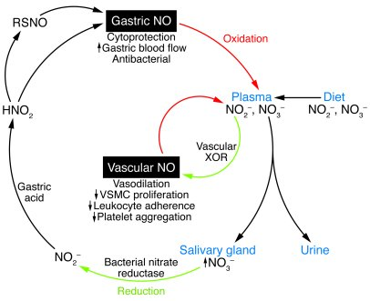
Reactions
Notes:
(Cooke & Ghebremariam, 2011)

Slide 4
Tyramine
Decarboxylation of tyrosine
Headaches
MAOIs and the hypertensive crisis
Notes:
-Usually formed by decarboxylation of tyrosine by microbes. It can lead to severe headaches, nausea etc.
-Sources include: Green/leafy vegetables, aged foods (cheeses, red wine, preserved meats)
-Monoamine oxidase inhibitors (antidepressants) inhibit the monoamine oxidase needed to break tyramine down.
-Nitrates can have similar effects.
(Rafehi et al., 2019)

Slide 5
Monoamine oxidase
Sodium nitrite can inhibit liver MAO by ~25% depending on other factors.
However, in other scenarios it increased MAO by up to 350%
Good or bad?
Dopamine, norepinephrine, serotonin
Other drugs: CNS stimulants, anxiolytics
Notes:
(EGASHIRA et al., 1971)

Slide 6
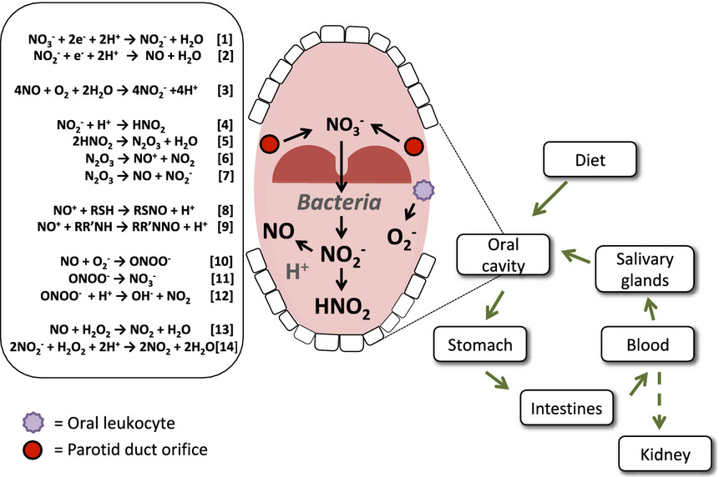
Oral Bacteria and Blood Pressure
Notes:
(Hezel & Weitzberg, 2013)

Slide 7
Food Matrix
Potential interfacial phenomenon- Study found that without lipid, vitamin C prevented the formation of some carcinogens. With lipid, vitamin C increased the formation of some carcinogens.
Any ideas why?
Notes:
-Vitamin C increases the activity of nitric oxide synthase, but that doesn’t really answer the question.
(Hord et al., 2009)

Slide 8
Debate
Argument for:
  Ancient eastern civilizations had high levels of nitrates in the diet.
  Can increase focus and athletic performance by increasing vascular perfusion and interfering with MAO. (maybe improve mood)
  Allowing oral bacteria to remain can help modulate blood pressure through the generation of nitric oxide.
  Can help delay coronary heart disease by causing vasodilation.
Argument against:
  People with certain pathologies can have different reactions.
  Nitrogen toxicity and adverse effects
  Tolerance and dependence
  Interfering with MAO and other pharmacological impacts
Notes:
Pathologies: A-fib
Adverse effects: postural hypotension, headache, tachycardia due to widespread vasodilation.
Tolerance to nitrates and the derivatives if nitrates develops quickly.
Dependence- Sudden cessation of prolonged nitrate exposure can cause loss of tone (spasming) in blood vessels.
-As stated before, nitrate drugs are used to treat heart disease, and the consumption of excess dietary nitrates can make the effects of those drugs variable. (dose issues).
Sources: (Menendez & Delpon, 1997) (Hord et al., 2009) (EGASHIRA et al., 1971) (Cooke & Ghebremariam, 2011)

Slide 9
References
Cooke, J. P., & Ghebremariam, Y. T. (2011). Dietary nitrate, nitric oxide, and restenosis . The Journal of Clinical Investigation, 121(4), 1258-1260. https://doi.org/10.1172/JCI57193
EGASHIRA, T., TAKANO, K., SHIMIZU, K., KUROSAWA, Y., & KAMIJO, K. (1971). EFFECT OF SODIUM NITRITE ON MONOAMINE OXIDASE ACTIVITY IN RAT LIVER AND BRAIN. Japanese Journal of Pharmacology, 21(2), 274-276. https://doi.org/10.1016/S0021-5198(19)36254-7
Hezel, M. P., & Weitzberg, E. (2013). The oral microbiome and nitric oxide homeostasis . Oral Diseases, 21(1), 7-16. https://doi.org/10.1111/odi.12157
Hord, N. G., Tang, Y., & Bryan, N. S. (2009). Food sources of nitrates and nitrites: the physiologic context for potential health benefits . The American Journal of Clinical Nutrition, 90(1), 1- 10. https://doi.org/10.3945/ajcn.2008.27131
Menendez, J. T., & Delpon, E. (1997). Pharmacologie des dérivés nitrés [Pharmacology of nitrates]
. Annales De Cardiologie Et D'Angeiologie, 380(90), 380- 390. https://pubmed.ncbi.nlm.nih.gov/9452771/
Rafehi, M., Faltraco, F., Matthaei, J., Prukop, T., Jensen, O., Vormfelde, S. V., Grytzmann, A., Blome, F. G., Berger, R. G., Krings, U., Tzvetkov, M. V., & Brockmoller, J. (2019). Highly Variable Pharmacokinetics of Tyramine in Humans and Polymorphisms in OCT1, CYP2D6, and MAO-A. Frontiers in Pharmacology, 10 https://www.ncbi.nlm.nih.gov/pmc/articles/PMC6831736/

