Slide 1
Formulating with Solid Fats: It’s All About Context
By: Gabrielle Scott

Slide 2
Applications for Solid Fats
All-purpose shortening
Fluid shortenings
Cake shortening
Icing shortening
Filler fat shortenings
Bread shortening
Frying shortening
Pie crust shortening
Pastry shortening
Confectioner’s fat

Slide 3
Methods for Obtaining Functional Fats
Hydrogenation
Interesterification
Process Control
Crystal Seeding
Additives

Slide 4
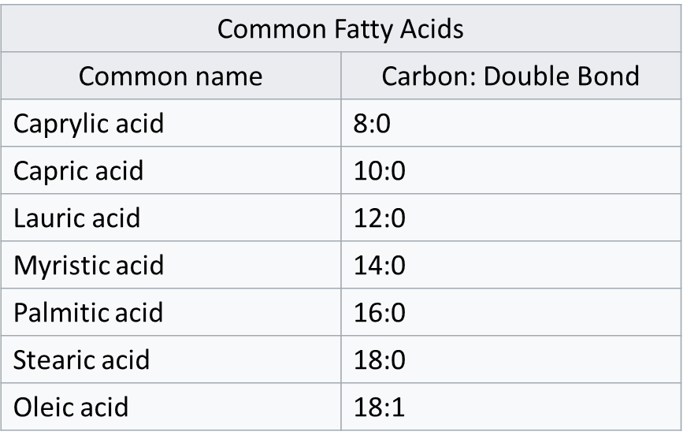
Triglyceride

Slide 5
Melting points of Fats: The basics
Melting point increases with:
Chain length
Saturation
Even chain FA
Trans fats ☹
Shortenings have a melting Range not Melting Point
TAGs can be broken into distinct groups based on melting point and functionality

Slide 6
Group I
Provides structure
Solid at room temp.
Group II
Structure and lubricity
Solid at room temp. and liquid at body temp.
Group III and Group IV
Imparts tenderness and richness
More unsaturated
Body temperature = 37°C
Room temperature = 20°C

Slide 7
Plastic fats
Plastic fats are a crystalline network on a continuous oil matrix
Polymorph forms
alpha (α)
beta-prime (β’)
Beta (β)
Most Functional
Thermodynamic stability
α
Β’
Β
Notes:
The beta-prime polymorph is usually the most functional in fat products, due to its small crystal size (1mm) and thin, needle shaped morphology.

Slide 8
Beta-prime-type (β′) | Beta-type (β)
Soybean | Cottonseed
Safflower | Palm
Sunflower | Tallow
Sesame | Milk Fat
Peanut
Corn
Olive
Coconut
Palm kernel
Lard
Cocoa butter

Slide 10
Crystallization
Heterogeneous – impurities, lower activation energy
Homogeneous – rare in shortening/margarine
Steps
Nucleation- Supersaturation and Supercooling
Crystal Growth – low temp
Crystal Ripening – long time

Slide 11
Process Control
Agitation
Agitation in the holding tubes prevents crystallization
Stick margarine vs. tub margarine
Tempering
Holding for 1-10 days after crystallization begins
Preferred polymorphic state
Delays β’ → β

Slide 12
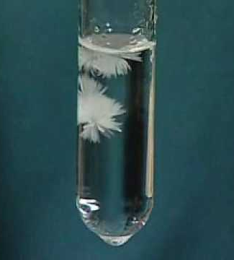
Seeding Crystals
Saturated or Unsaturated TAGs (triacylglycerols)
Seed should have same polymorphic state as desired (β’ or β)
Prevents incomplete crystallization
Reduces temperature sensitivity

Slide 13
Crystallization Modifiers and Additives
Diacylglycerols (DAGs)
Monoacylglycerols (MAGs)
Sorbitan esters (SE)
Sucrose esters of fatty acids (SEFAs)
Lecithin
Polyglycerol polyricinoleate (PGPR)
Minor Lipids
Emulsifiers

Slide 14
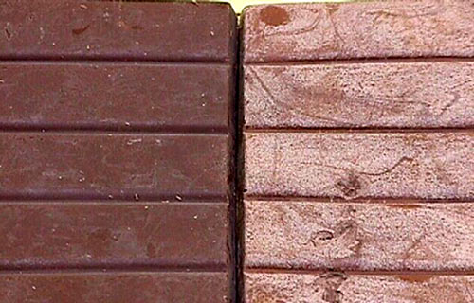
Retaining β’ Structure
β’ → β – Fat Bloom
>2-3% additives will limit β’ formation
Polyglycerol polyricinoleate (PGPR) + Lecithin
slowing the α→β′→β transitions
Diacylglycerols (DAGs)
Inhibits crystal growth and nucleation
Palm oil prevents conversion of β’ to β
Less homogeneity of FA chain length

Slide 15
Applications for Solid Fats
Fluid shortenings → Lecithin inhibits crystallization
Cake shortening → Mono/Di- glycerides form complex with amylose
Icing shortening → β’ stable for smoothness and aeration
Filler fat shortenings → PHOs + emulsifiers for stability
Bread shortening → Solid fat content strengthens dough
Frying shortening → flavor, frying, oxidative stability (context dependent)
Pie crust shortening → NO emulsifiers for non-uniform fat distribution
Pastry shortening → 70:30 lard:hydrogenated oil for stability
Confectioner’s fat → TAGs that melt at 32-35°C

Slide 16
Consumer Education and Expectation
Consumer may not understand why you used that ingredient but that won’t stop them from caring!
Example: Have you ever heard of Rapeseed oil?
Canola Oil is made from rapeseeds low in erucic acid and glucosinolates.
Can
+
ola
Canadian
Oil

Slide 17
References
1. Ravotti, R.; Worlitschek, J.; Pulham, C.R.; Stamatiou, A. Triglycerides as Novel Phase-Change Materials: A Review and Assessment of Their Thermal Properties. Molecules (Basel, Switzerland) 2020, 25, 5572.
2. Nguyen, V.; Rimaux, T.; Truong, V.; Dewettinck, K.; Van Bockstaele, F. Granular Crystals in Palm Oil Based Shortening/Margarine: A Review. Crystal growth & design 2020, 20, 1363-1372.
3. Sato, K. Crystallization behaviour of fats and lipids — a review. Chemical engineering science 2001, 56, 2255-2265.
4. Wiedermann, L.H. Margarine and margarine oil, formulation and control. Journal of the American Oil Chemists' Society 1978, 55, 823-829.
5. Ribeiro, A.; Ribeiro, A.; Masuchi, M.; Masuchi, M.; Miyasaki, E.; Miyasaki, E.; Domingues, M.; Domingues, M.; Stroppa, V.; Stroppa, V.; de Oliveira, G.; de Oliveira, G.; Kieckbusch, T.; Kieckbusch, T. Crystallization modifiers in lipid systems. J Food Sci Technol 2015, 52, 3925-3946.
6. GHOTRA, B.S.; DYAL, S.D.; NARINE, S.S. Lipid shortenings: a review. Food research international 2002, 35, 1015-1048.

