Slide 1
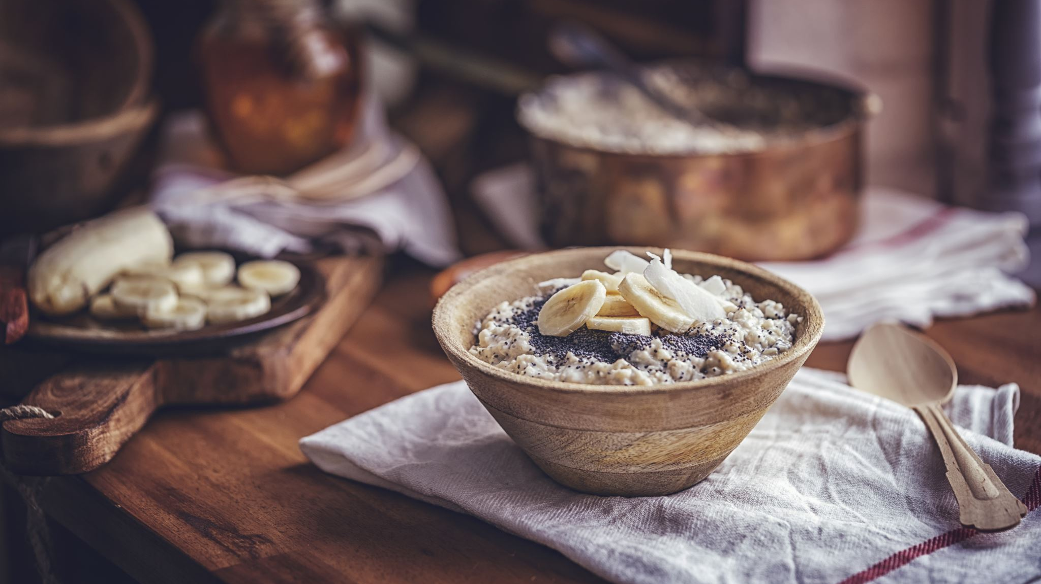
Dietary Antioxidant and Human Health
Presenter: Ganga Sah
Food Chemistry (NFSC 605)

Slide 2
Antioxidants
Antioxidants are compounds that directly scavenge or inhibit free radicals and thereby prevent cell damage
Antioxidants can be categorized as-
Natural antioxidants: Vitamin C, Vitamin E, carotenoids
Synthetic antioxidants: butylated hydroxy anisole (BHA), butylated hydroxy toluene (BHT), propyl gallate (PG) and tert-butyl hydroquinone (TBHQ)

Slide 3
Dietary sources of antioxidants
Antioxidants | Main dietary sources
Vitamin E | Wheat germ oil, almonds, sunflower oil, safflower oil, olive oil, hazelnuts
Vitamin C | Fruits (mainly citrus fruits), vegetables, tomatoes
Flavonoids | Potatoes, tomatoes, lettuce, onions, apples, wheat bran, dark chocolate, red wine, coffee, black tea
Lycopene | Tomatoes and tomato products, apricots, pink grapefruits, guava, skin of red grapes, papaya and watermelon
β-Carotene | Carrots, pumpkins, papayas, peaches, sweet potatoes, apricots, cabbage, green beans, broccoli, brussel spouts, lettuce, peas, spinach, tomatoes, pink grapefruit, oranges
CoQ10 | Fish and meat
Source: Kaliora et al. (2006)

Slide 4
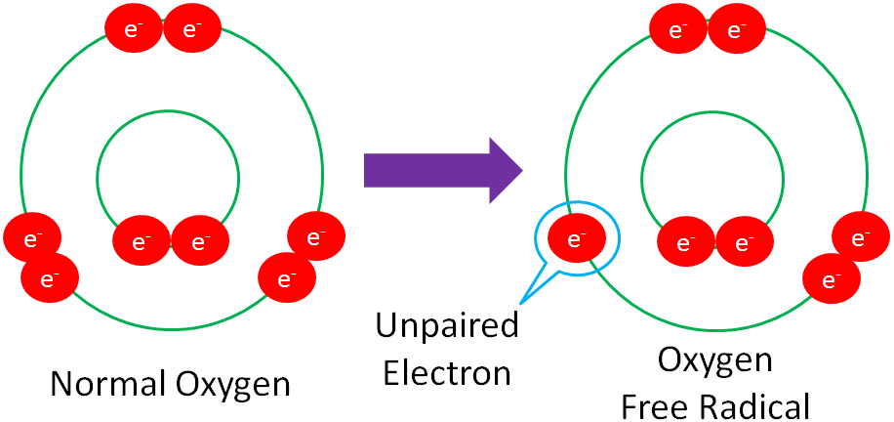
Free radicals
Free radicals are uncharged molecule with unpaired electron
reactive oxygen species (ROS) and
reactive nitrogen species (RNS)
Not always harmful for us
Free radicals are derived from both endogenous sources (eg. mitochondria) and exogenous sources (eg. Pollution)
Free radicals are unstable and highly reactive
Due to its reactivity, it extracts electrons from compounds and oxidizes biomolecules such as DNA, RNA, lipids and proteins

Slide 5
Pathways of ROS production and clearance
Source: Droge (2002)

Slide 6
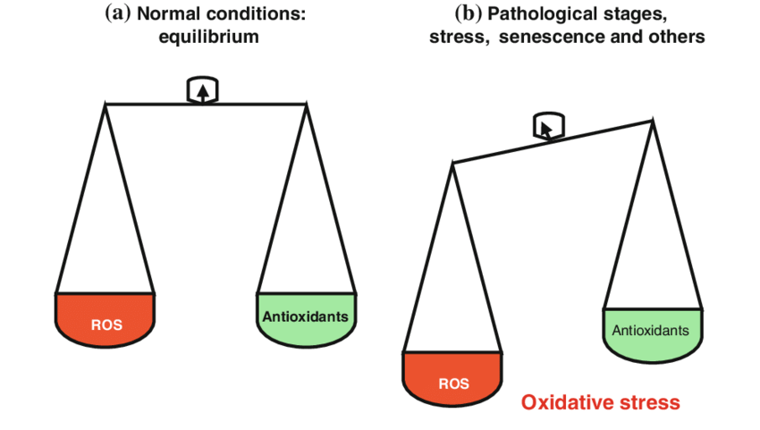
Antioxidants and ROS
To maintain a good health, proper balance between ROS generation and the antioxidant systems is important.
When ROS overwhelms the antioxidant-defense systems, oxidative stress is indicated (Yang et al., 2018)
Fig: adapted from internet

Slide 7
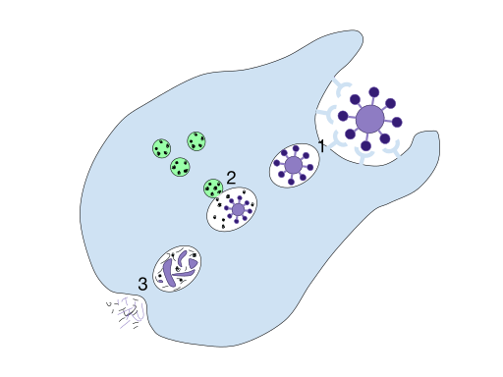
Antioxidants Vs Free Radicals
Source – Biology Dictionary

Slide 8
Antioxidant supplements could be harmful ?
Excess antioxidants in cancer
Antioxidants as prooxidant
Radical scavengers found in food are mostly sacrificial antioxidants and gets oxidized by ROS in human body
So, dietary antioxidant should be translated to reduce oxidative stress, thereby helping to maintain normal function of human organs

Slide 9
Dietary antioxidants and cancer
Optimal antioxidants comes from diet rather than supplemented in pills or tablets.
Higher doses of antioxidant increases incidence of cancer rather than its prevetion
antioxidant prevent cancer in individual with insufficient antioxidant but have negative effect in individuals with sufficient antioxidant consumption (Bjelakovic et al., 2014)

Slide 10
Antioxidants as prooxidant
Antioxidants under aerobic condition generates superoxide radicals and forms H₂O_{2,} which forms toxic reactive oxygen species (ROS) on reaction with reduced metal ions and superoxide
For example, flavonoids can react as prooxidants when a reduced metal is available
Tocopherols can also act as prooxidants when transition metals such as Cu(I) are present, but this depends on the matrix environment in which it is present
Source: Sotler et al.( 2019)

Slide 11
Two faces of Vitamin C
1) Beneficial effects of Vitamin C
In mitochondria – energy is produced along with free radicals which may damage mitochondrial DNA
In presence of antioxidants such as Vitamin C, it quench the free radicals and stabilizes the mitochondrial membrane

Slide 12
Two faces of Vitamin C
2) Harmful effects of Vitamin C
Vitamin C at low dose acts as antioxidant while at high dose acts as prooxidant
Vitamin C dose is important: (Mendes-da-Silva et al., 2014)
30 mg/kg/d AA decelerated Cortical Spreading Depression (CSD) and reduced malondialdehyde (formed during lipid peroxidation) levels,
60 and 120 mg/kg/d accelerated CSD and augmented malondialdehyde levels compared with the corresponding saline and naive groups
Malondialdehyde (MDA) – marker of oxidative stress and antioxidant status in cancer patients

Slide 13
Negative effects of Antioxidants
High doses of beta – carotene has been linked to increased risk of lung cancer among smokers
High dose of Vitamin E supplements has been linked to increased risks of hemorrhagic stroke (a type of stroke caused by bleeding in the brain) and prostate cancer

Slide 14
Conclusion
Variation in evidences for effects of antioxidants- both positive and negative
Challanges – no reliable methods to determine antioxidant capacity and oxidative stress status in human body
-In absence of proven biomarkers, difficult to tell whether a diet is balanced or not
Research evidence suggest
- consumption of fruits and vegetables lowers the risks of several diseases
BUT
- It is not clear if it is due to antioxidant content or other compounds present in the fruits and vegetables.
∴ Investigation of mechanism of dietary antioxidants using reliable methods and biomarkers is warranted!

Slide 15
References
Bjelakovic, G., Nikolova, D., & Gluud, C. (2014). Antioxidant supplements and mortality. Current Opinion in Clinical Nutrition & Metabolic Care, 17(1), 40-44.
Mendes-da-Silva, R. F., Lopes-de-Morais, A. A. C., Bandim-da-Silva, M. E., de Araujo Cavalcanti, G., Rodrigues, A. R. O., da Silveira Andrade-da, B. L., & Guedes, R. C. A. (2014). Prooxidant versus antioxidant brain action of ascorbic acid in well-nourished and malnourished rats as a function of dose: a cortical spreading depression and malondialdehyde analysis. Neuropharmacology, 86, 155-160.
Sotler, R., Poljšak, B., Dahmane, R., Jukić, T., Jukić, D. P., Rotim, C., ... & Starc, A. (2019). Prooxidant activities of antioxidants and their impact on health. Acta Clinica Croatica, 58(4), 726.
Yang, C. S., Ho, C. T., Zhang, J., Wan, X., Zhang, K., & Lim, J. (2018). Antioxidants: Differing meanings in food science and health science. Journal of agricultural and food chemistry, 66(12), 3063-3068.
Dröge, W. (2002). Free radicals in the physiological control of cell function. Physiological reviews.
Kaliora, A. C., Dedoussis, G. V. Z., & Schmidt, H. (2006). Dietary antioxidants in preventing atherogenesis. Atherosclerosis, 187(1), 1-17.
https://www.nccih.nih.gov/health/antioxidants-in-depth#:~:text=However%2C%20high%2Ddose%20supplements%20of,and%20one%20type%20of%20stroke.

