Slide 1
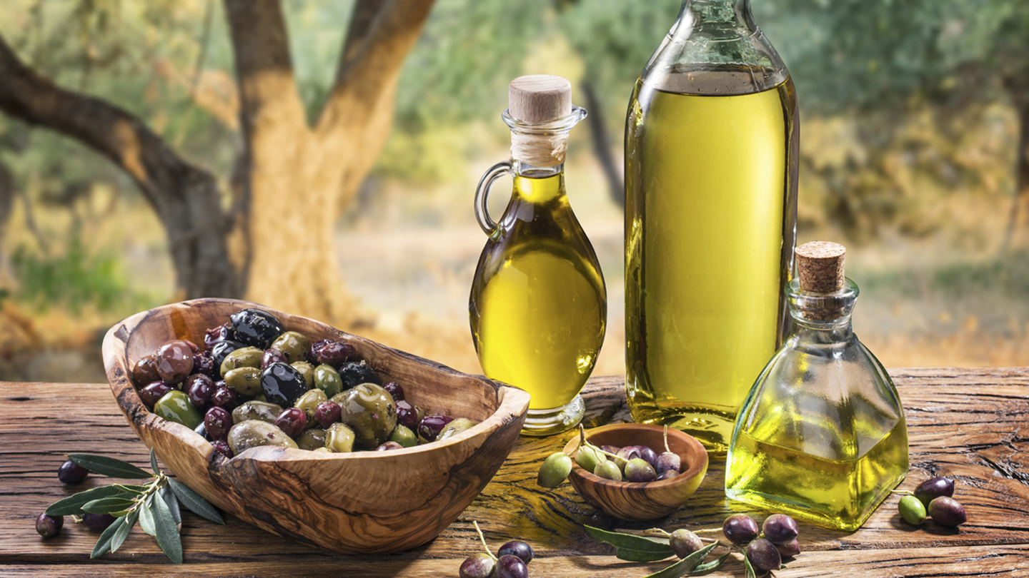
OLIVE OIL FRAUD IN WORLD MARKET
PRESENTER : BARSHA BASTOLA

Slide 2
World market of olive oil
3:14
In the year 2020, global consumption of olive oil was 3.14 million tons
13:03
Global market size was 13.03 billion USD in 2019 and is expected to be 16.64 billion USD by 2027

Slide 3
Why is there fraud on olive oil market ?
Rapidly increasing demand of olive oil is subjected to massive production
Categorization of olive oil (extra virgin, virgin, lampante virgin, refined, )
Consumer preference
Manufacturers and suppliers taking advantage of the situation to take maximum economic benefit

Slide 4
How is the fraud happening?
Extra virgin oil is the expensive one among all and hence is more prone to adulteration
Addition of other oils like sunflower, soyabean, hazelnut to olive oil is a common adulteration practice
Mislabeling of the product
Misleading origin

Slide 5
Approaches for authentication
International Olive oil Council (IOC) standard is the most widely used
Others are USDA, Californian state regulation, European commission standard, Australian standard, Codex alimentarium regulation
Huge debate on standard setting and effectiveness of official analytical methods

Slide 6
Olive oil quality criteria
Content of free fatty acids
Peroxide value (PV)
Ultraviolet specific extinction coefficients
Content of fatty acid alkyl esters
Content of pyropheophytins
1,2-diacylgylcerols
Sensory quality
Fatty acid composition

Slide 7
Olive oil purity criteria
Fatty acid composition
Fatty acid trans isomers content
Difference between actual and theoretical content of triacylgylcerols
Sterols
Triterpene dialcohols
Wax esters
Total aliphatic alcohols content
Stigmastadienes
2-glyceryl monopalminate

Slide 8
Analytical tools to detect olive oil adulteration
Vibrational spectroscopic technique- rapid measurement, fast data acquisition, low cost, non-destructive sampling
Nuclear magnetic resonance (NMR) spectroscopy- used for virgin olive oil adulteration control, quantitative analysis TAGs, trans and cis FAs and sterols
Mass spectroscopy- used to detect extra virgin olive oil adulterant vegetable oil specifically hazelnut, expensive
Chromatographic techniques- short time, hard to adopt, limited studies
Others like DNA based, electronic nose and tongue based, thermal techniques, isotopic techniques

Slide 9
Challenges of using analytical tools
Characteristics of conventional analytical methods for olive oil quality and authenticity
Limitation of conventional methods for olive oil adulteration control
Lack of standardized workflow

Slide 10
Conclusion and discussion
Variation in olive oil composition due to agro-ecological zones and practices
Limitations of the conventional analytical method can be overcome by use of advanced analytical tools, data mining and analysis
Proposed methods had limited sample variation
Potential analytical tools are costly hence not commonly practicable
Further studies is needed for development of cost-effective analytical techniques and sample representation

Slide 11
References
Bajoub, A., n.d. Olive oil authentication: A comparative analysis of regulatory frameworks with especial emphasis on. CRITICAL REVIEWS IN FOOD SCIENCE AND NUTRITION 27.
Putative markers of adulteration of extra virgin olive oil with refined olive oil: Prospects and limitations | Elsevier Enhanced Reader [WWW Document], n.d. https://doi.org/10.1016/j.foodres.2013.05.008
Leading consumers of olive oil worldwide 2020/21 [WWW Document], n.d. . Statista. URL https://www.statista.com/statistics/940532/olive-oil-consumption-worldwide-by-leading-country/ (accessed 4.20.21).

Slide 12
Any queries ?

