Slide 1
Meat as a Functional Food
Zena Hicks
NFSC 605
April 4, 2019

Slide 2
Global Meat Consumption
Kilograms/capita
Organisation for Economic Co-operation and Development - OECD Agriculture Statistics: OECD-FAO Agricultural Outlook (Edition 2018)
Notes:
US – sheep = 0.4 kg (0.88 lb)
Pork = 24 kg (52.8)
Beef and veal = 27.1 kg (59.62)
Poultry = 49.8 (109.56)
Total = 101.3 (222.86)

Slide 3
Red Meat in the Diet
9.3% calories
21.7% protein → All 9 essential amino acids, Biological Value = 75-85%
17.4% fat
SFAs = 20.3%
MUFAs = 18.7%
PUFAs = 6.7%
Vitamins
A (17.5%), Niacin (18.1%), Riboflavin (13.1%), Thiamin (16.4%), Folate (4.3%), B6 (22.0%), B12 (58.5%), C (0.9%), E (2.0%)
Minerals
Calcium (1.3%), Phosphorus (14.6%), Magnesium (6.5%), Iron (10.6%), Zinc (30.4%), Copper (9.8%), Potassium (10.5%)

Slide 4
What is a functional food?
“A food may be considered functional if it contains a component (be it nutrient or not) with a selective effect on one or various functions of the organism, whose positive effects justify that it can be regarded as functional (physiological) or even healthy.” – Pascal and Collet-Ribbing, 1998.
“A food can be regarded as functional if it satisfactorily demonstrated to beneficially affect 1 or more target functions in the body, beyond adequate nutritional effects, in a way that is relevant to either improved health or well-being and/or to a reduction in the risk of disease. A functional food must remain food and it must demonstrate its effects in amounts that can normally be expected to be consumed in the diet: it is not a pill or capsule, but part of the normal food pattern.” – Fernandez-Gines et al. 2005

Slide 5
How can meat become a functional food?
Adding ingredients considered beneficial for health
Fresh meat products
Injections/marinades
Processed meat products
Removing/reducing ingredients that are considered harmful
Processed meats

Slide 6
Pre-harvest diet manipulations
Changing fatty acids profile of the diets
Increasing PUFA in meat
Swine
Cattle and sheep
Addition of alpha-tocopherols
Added antioxidant
Longer shelf life of product
Effect for humans?

Slide 7
Pre-harvest diet manipulations
Probiotics
Beta-agonists
Non-hormonal compounds fed that bind fat cell receptors and reduce or redirect fat metabolism or bind to muscle cell receptors to change muscle fiber size
Leads to leaner, heavier carcasses
Zilpatoral (Zilmax), Ractopamine (Optaflexx)
Hormone implants
Increase growth and protein deposition
Estrogenic or androgenic

Slide 8
Post-harvest interventions
Addition of different oils
Olive Oil
High oleic sunflower oil
Linseed oil
Fish oil
Nuts
Addition of soy
Soy protein isolates (SPI), Soy protein concentrate, soy isoflavones
Addition of natural antioxidants
Rosemary, sage, tea, seasame seed, olives, grapes, citrus peel
Reduction of salt

Slide 9
Role of Fiber in Processed Meats Products
Dietary Fiber = “The edible parts of plants and analogous carbohydrates that are resistant to digestion and absorption in the human small intestine with complete or partial fermentation in the large intestine”
Functions/Advantages
Water binding → 300 – 2,000%
Oil absorption → 200 – 600%
Fat mimetic/replacer
Possible Disadvantages
Flavors
Colors
Prohibition of fiber enrichment of meats
Labelling issues

Slide 10
Addition of Fiber
Assessment of vegetable based fibers in ground beef intended for international meat formulations
J. Ball, J. Sawyer, B. Lambert, H. Ramirez, L. Adcock, R. Wyatt, J. Costilla, M.B. Mora Garcia
Tested different types of fiber (Oat, Pea, and Rice) with a control formulation. All batches included 78.1% beef, 17% water, 3.5% select vegetable fiber, 0.75% salt, 0.4% phosphate, 0.25% black pepper
Found that all fibers added increased the shear force values compared to control
Greater cook yields when fibers were added
Adding vegetable fibers increased surface L* values and decreased surface a* and b* values.

Slide 11
Addition of Fiber
Assessment of oat fiber technology in ground beef intended for international meat formulations
J. Ball, J. Sawyer, B. Lambert, H. Ramirez, L. Adcock, R. Wyatt, J. Costilla
Tested different levels of oat fiber (0, 1.5, 3.5, and 4.5%) in a formulation including 17% water and fiber, 0.75% salt, 0.4% phosphate, and 0.25% black pepper
Found that greater amounts of oat fiber lead to greater cook yields, lower cooked a* values, increased shear force values (P < 0.05).
Greater cook times with 3.5 and 4.5% oat fibers.
No changes in lipid oxidation with differing amounts of oats.

Slide 12
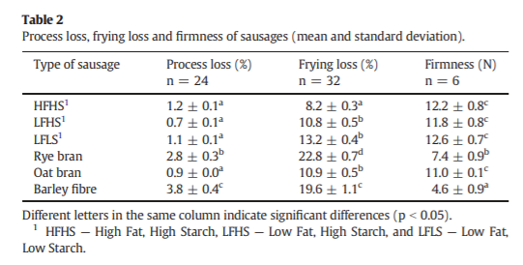
Addition of Fiber

Slide 14
Future Applications
Advantages
Lower cost formulations
Increased cooking yields, decreased incidence of persistent pinking
Health appeal in labelling and marketing of products
International possibilities
Possible roadblocks
Public perception
Regulations/Labelling

Slide 15
Sources
Ball, J., Sawyer, J., Lambert, B., Ramirez, H., Adcock, L., Wyatt, R., Costilla, J. Assessment of oat fiber technology in ground beef intended for international meat formulations. J. Meat Sci. 112:120-121. 2016.
Ball, J., Sawyer, J., Lambert, B., Ramirez, H., Adcock, L., Wyatt, R., Costilla, J., Mora Garcia, M.B., Assessment of vegetable based fibers in ground beef intended for international meat formulations. J. Meat Sci. 112:121. 2016.
Bodner, J. M., & Sieg, J. (2009). Fiber. In R. Tarté (Ed.), Ingredients in Meat Products: Properties, Functionality and Applications (pp. 83-109). New York, NY: Springer Science & Business Media.
Fernandez-Gines, J.M., Fernandez-Lopez, J., Sayas-Barbera, E., Perez-Alvarez, J.A. Meat products as functional foods: a review. J. Food Sci. 70(2): R37-R43. 2005.
OECD Agriculture Statistics: OECD-FAO Agricultural Outlook. (2018). Retrieved from Organization for Economic Co-operation and Development website: https://data.oecd.org/agroutput/meat-consumption.htm
Pascal, G., Collet-Ribbing, C. 1998. Las perspectives europeas sobre los alimentos funcionales. Institute for Prospective Technological Studies: Sevilla, Spain. IPTS Report 24:1-7.
Petersson, K., Godard, O., Eliasson, A., Tornberg,E. The effects of cereal additives in low-fat sausages and meatballs. Part 2: Rye bran, oat bran and barley fibre. J. Meat Sci. 96:503-508. 2014.

Slide 16
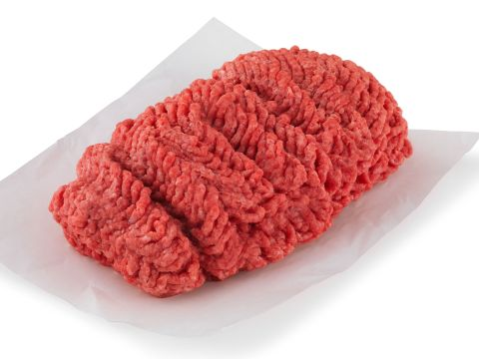
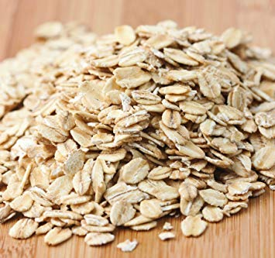
Questions?

