Slide 1
Protecting n-3 Fatty Acids in Foods and Supplements -Rachel McNicholas

Slide 2
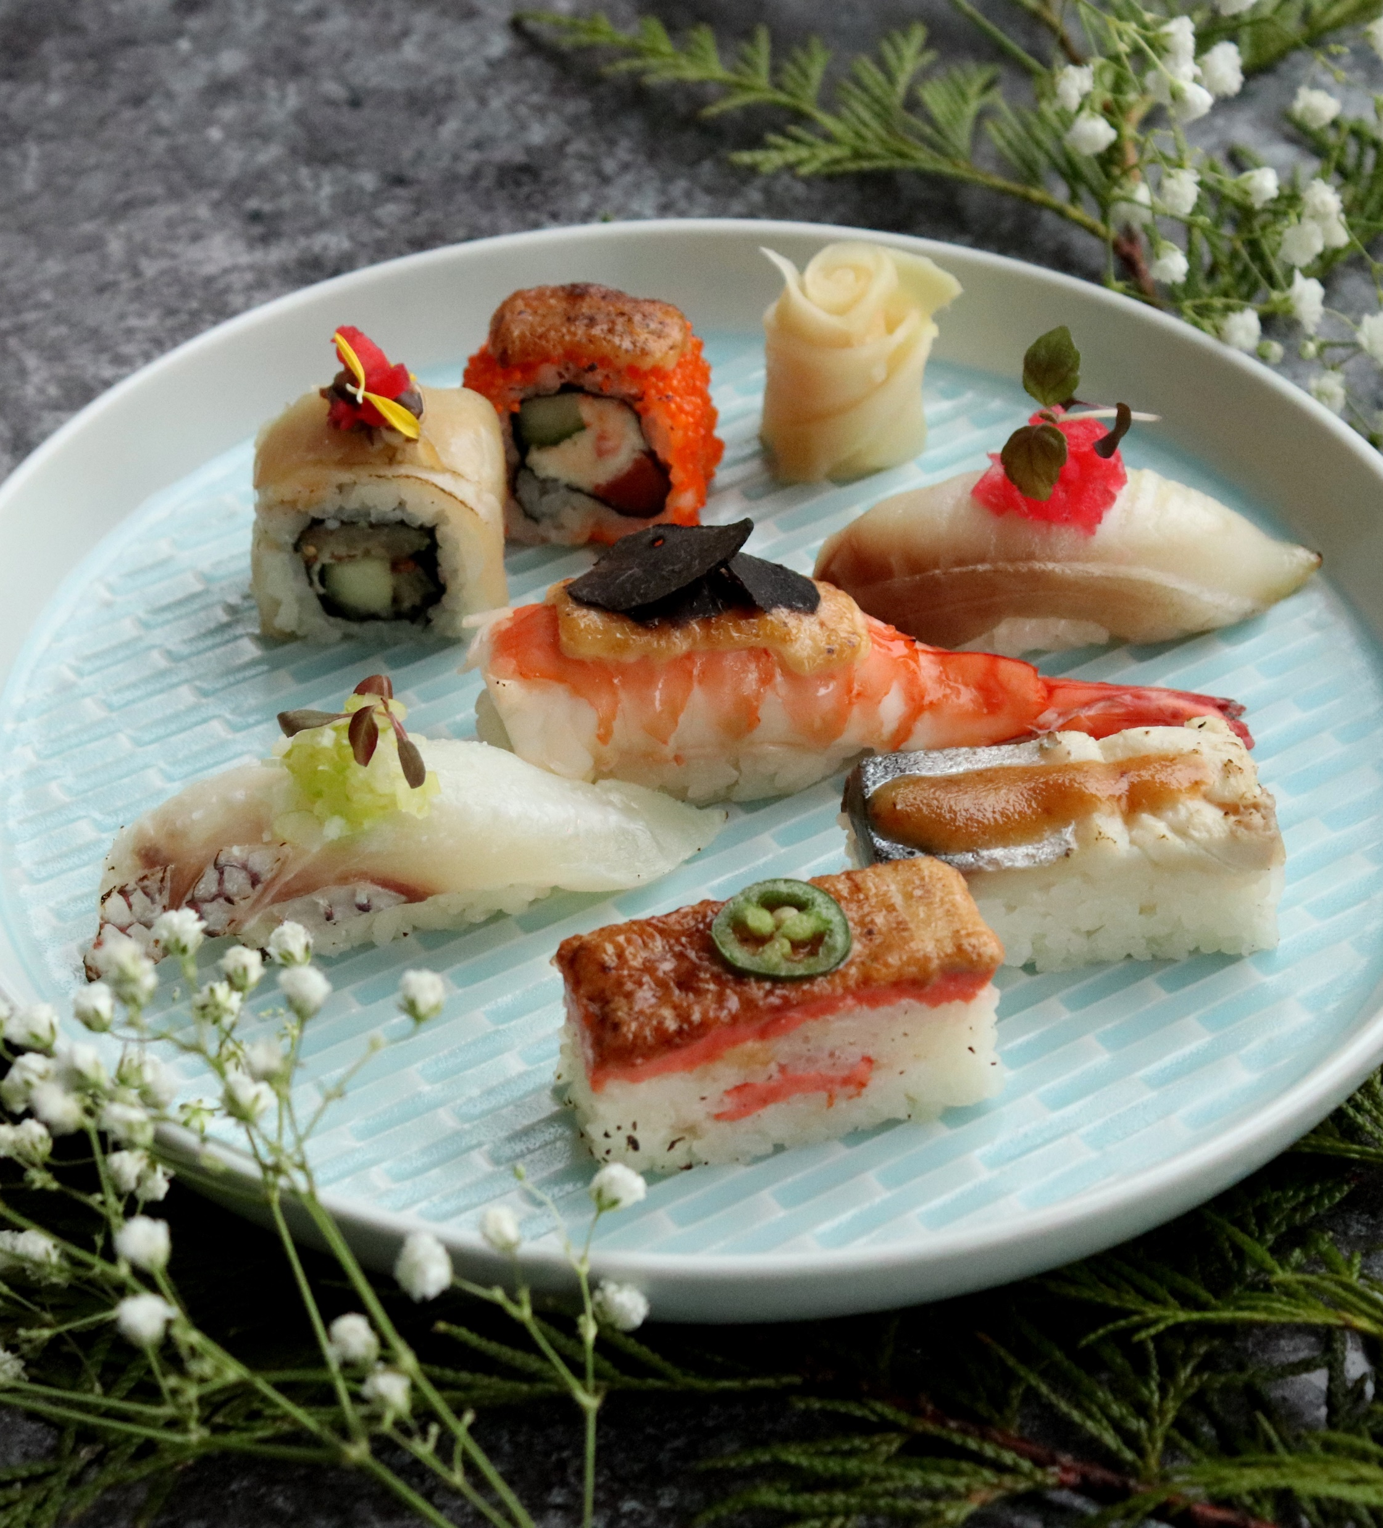
Background Information
In the 1970’s scientists discovered the Eskimos & the Japanese had low levels of cardiac incidents despite consuming large amounts of fish fats
Due to this discovery, people started eating more healthy fish and oils, and interest in researching the beneficial health effects of these oils increased
Although these oils are healthy, polyunsaturated fatty acids (PUFAS) are highly susceptible to lipid oxidation, especially ω-3’s
ω-3 fatty acids are found mainly in fish oil, but are present in green leafy vegetables & oils including:
Canola oil
Flaxseed oil
Walnut oil

Slide 3
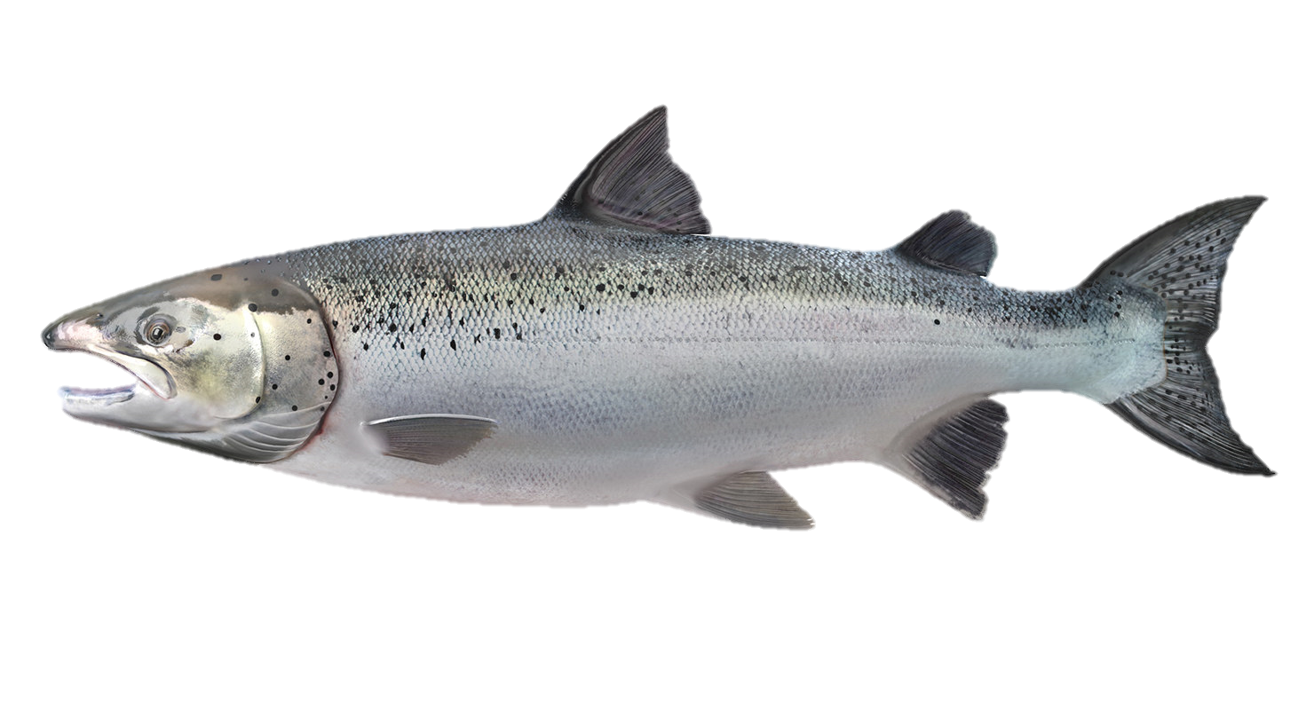
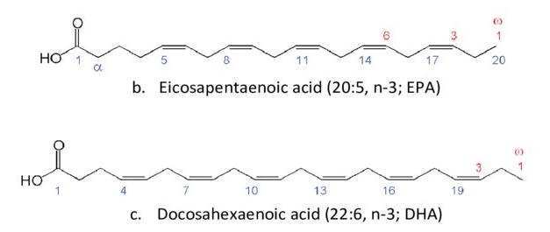
Fish Oils
Main ω-3 fatty acids in fish oil:
Docosahexaenoic Acid (DHA)
Eicosapentaenoic Acid (EPA)
Posses Unique Qualities due to:
↑ degree of unsaturation and number of carbon atoms
↑ concentration of long-chain ω-3 PUFA’s
Large quantity and variety of fatty acids in tryacylglycerols
Concentration of ω-3’s affected by:
Age of Fish
Fishing Season
Species of Fish
Area of Living
Water Temperature

Slide 4
Concentration of ω-3’s by Species

Slide 5
Health Benefits
Lower mortality risk from existing coronary heart disease, as well as sudden cardiac death and non-fatal coronary events
Clinical trials with rheumatoid arthritis patients have shown a decrease in associated symptoms and long term usage of non-steroidal anti-inflammatory drugs (NSAIDs)
May play a role in the prevention and promotion of several types of cancer
Therapeutic effects have been noted in patients with mental health disorders such as schizophrenia, depression, and ADHD
May prevent or slow development of Alzheimer’s
Critically important in long-term cognitive, visual, and motor development in infants, esp. DHA

Slide 6
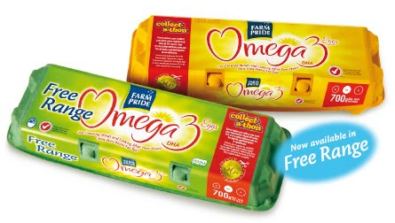
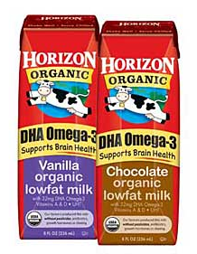
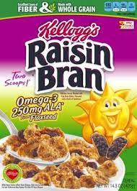
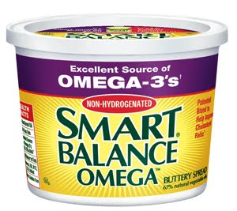
Product Enrichment w/ω-3’s
Meat and Poultry
Bread and Bakery Products
Spreadable Fats
Eggs and Egg Products
Milk and Dairy Products
Pasta
Sauces
Juices & Soft Drinks
Instant Concentrates

Slide 7
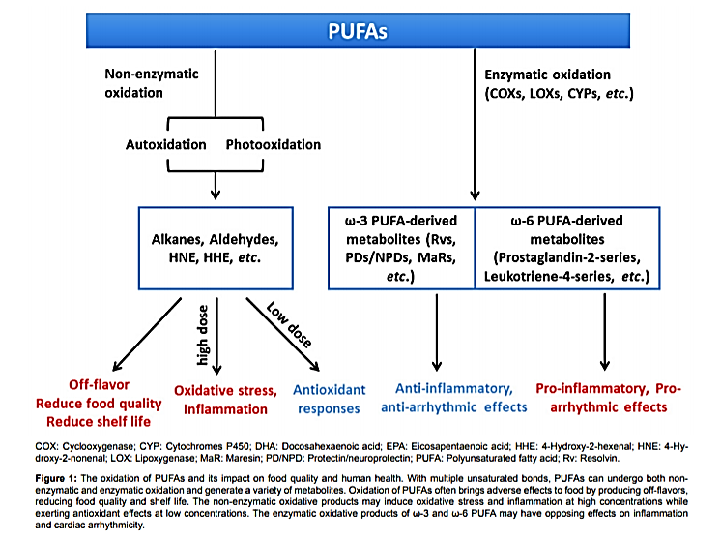

Slide 8
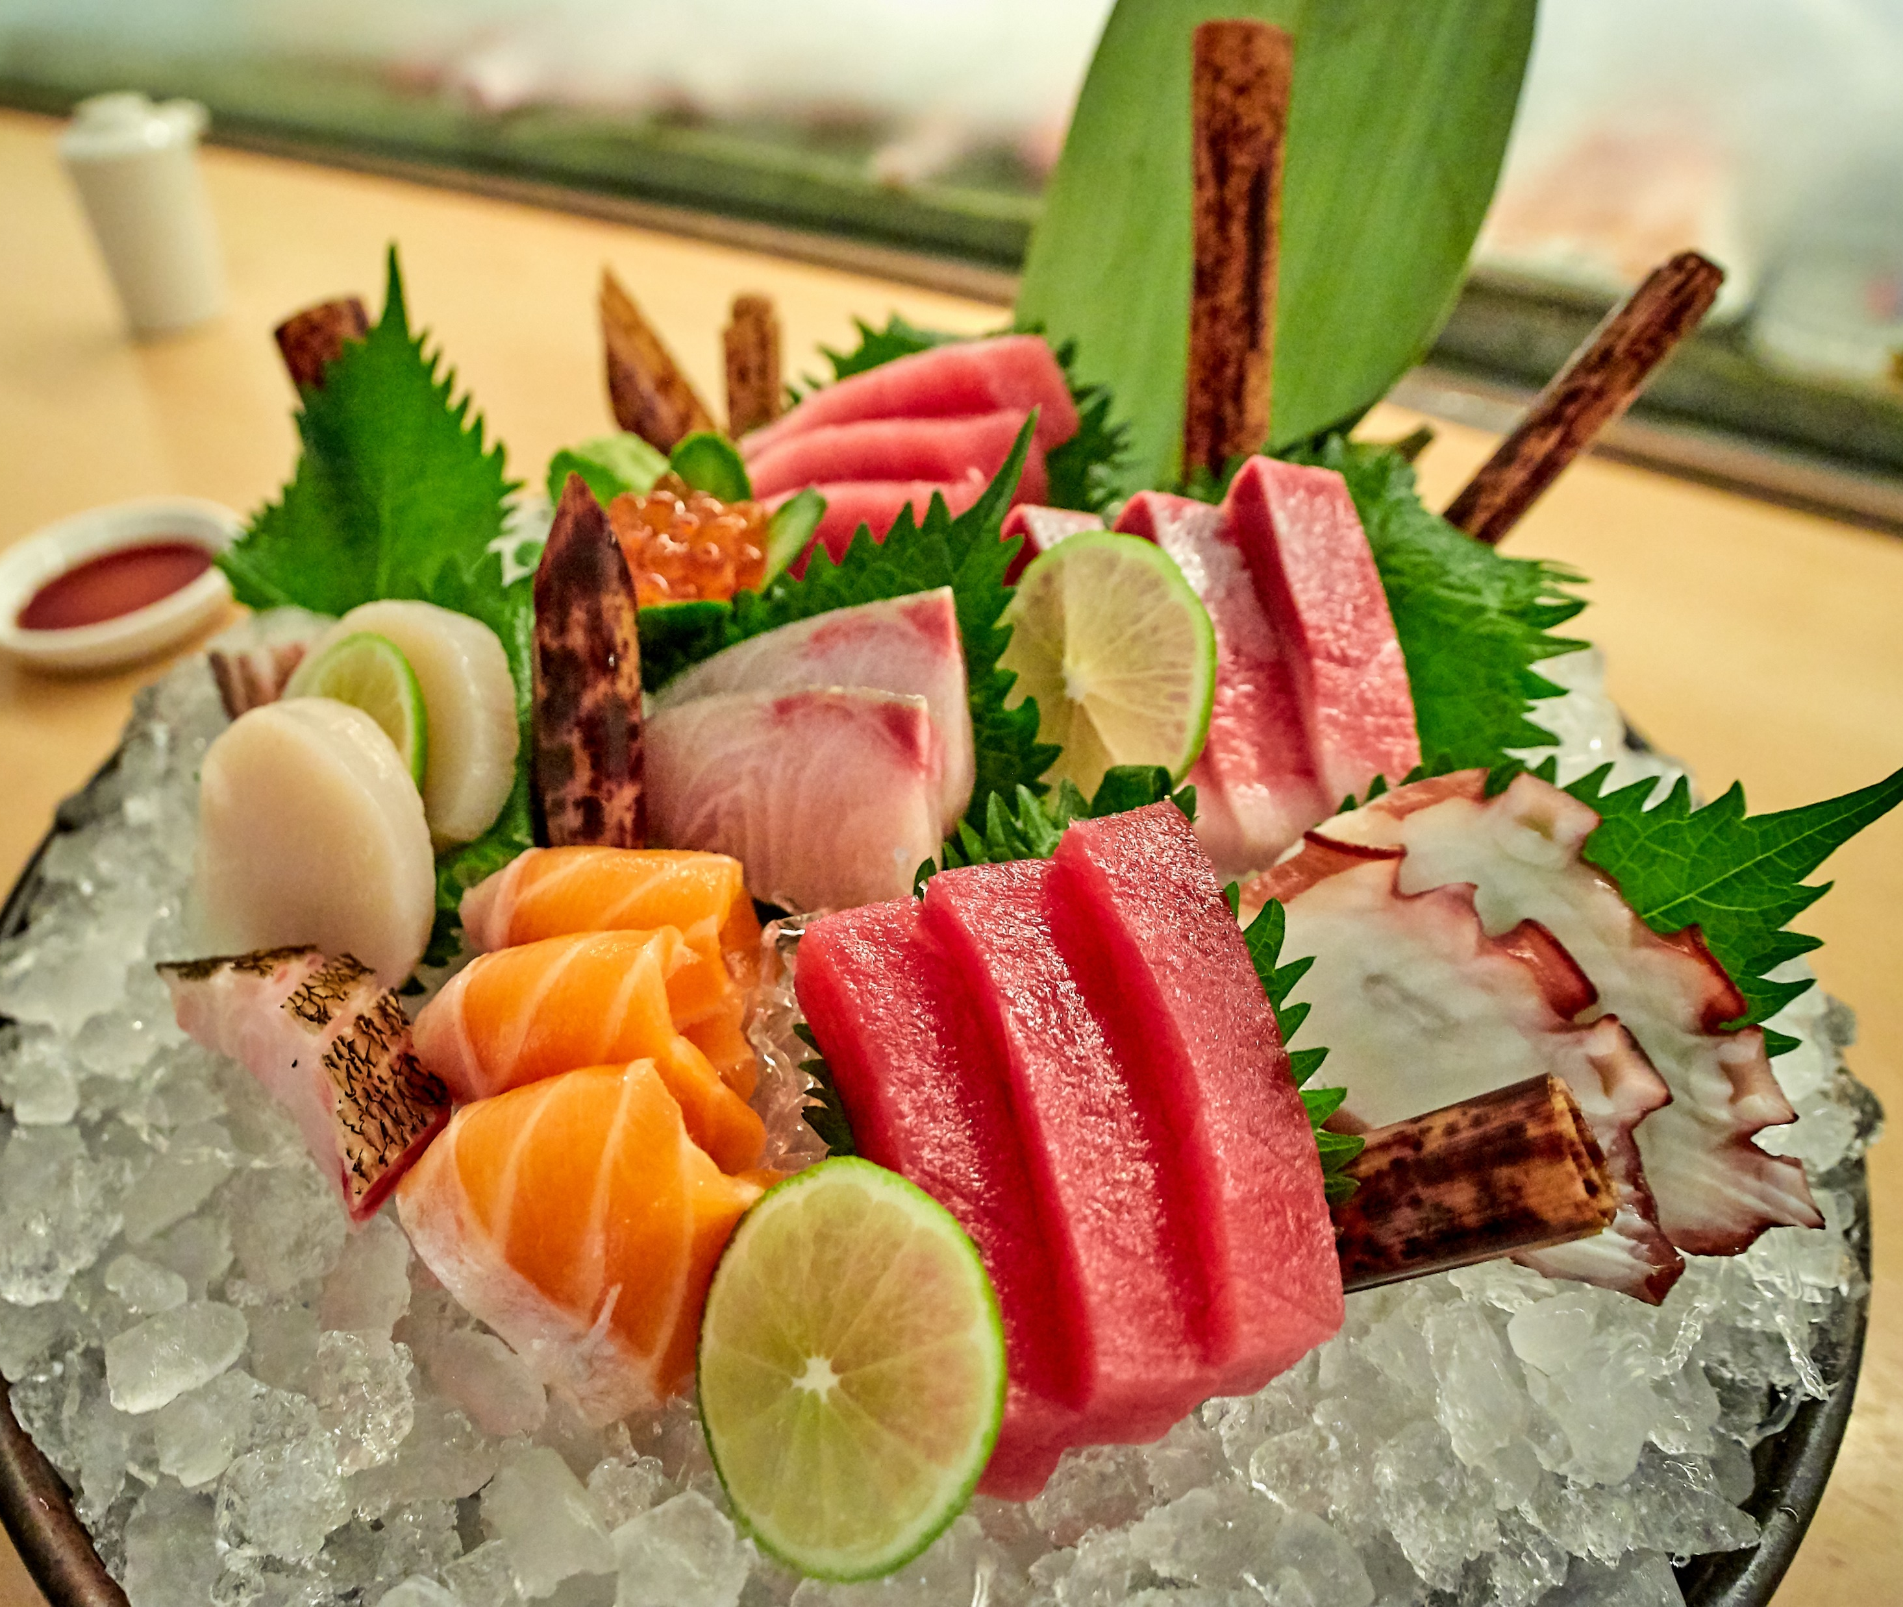
Oxidation in ω-3’s
Very susceptible to oxidation due to ↑ degree of unsaturation
Negatively impacts sensory qualities of foods
Off/Loss of flavors
Odors
Color Changes
Reduces nutritive quality
Decreases food safety

Slide 9
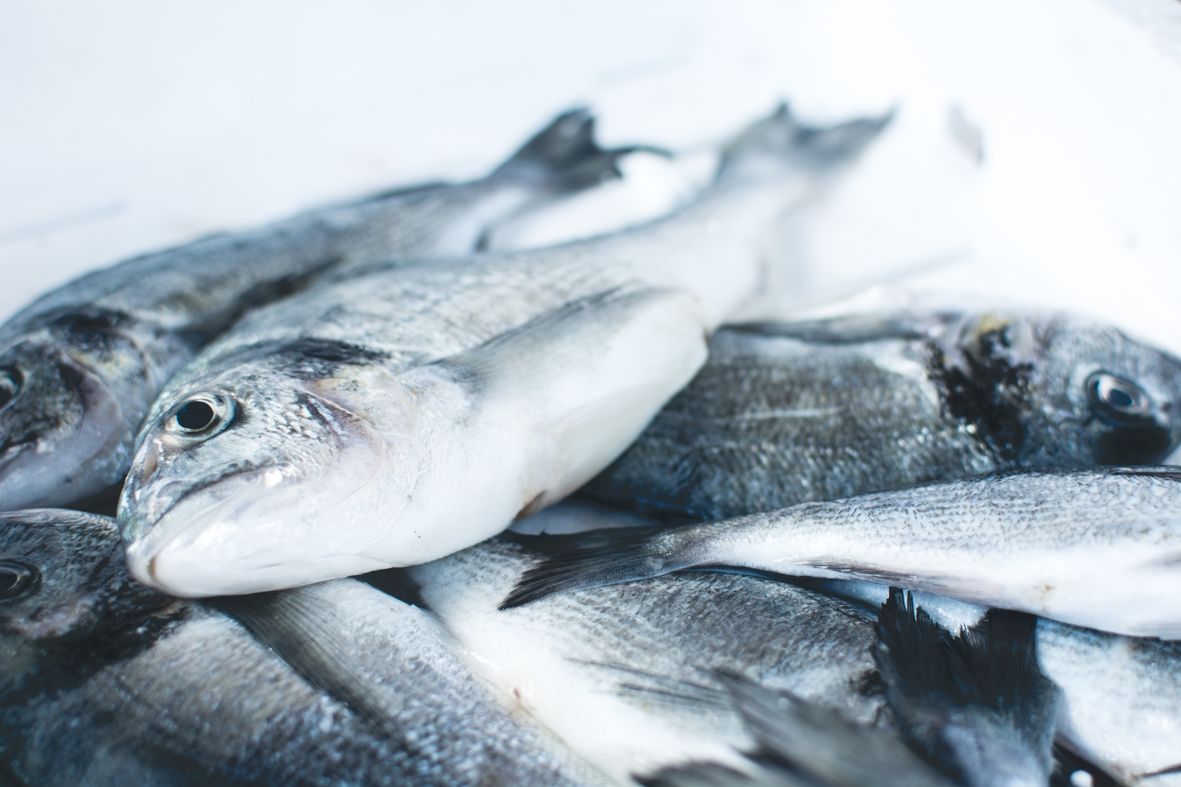
Antioxidant Protection of ω-3’s
Antioxidants can prevent oxidation of lipids
Several antioxidants have been studied to stabilize long chain PUFAs:
α-Tocopherol
δ-Tocopherol
EDTA
Ascorbic acid
Lecithin
Ferulic acid
Effectiveness & application depends on product type
A study conducted showed that combining a mixture high in δ-Tocopherol & low in α-Tocopherol, w/ ascorbyl palmitate & lecithin effectively reduce oxidation in ω-3’s

Slide 10
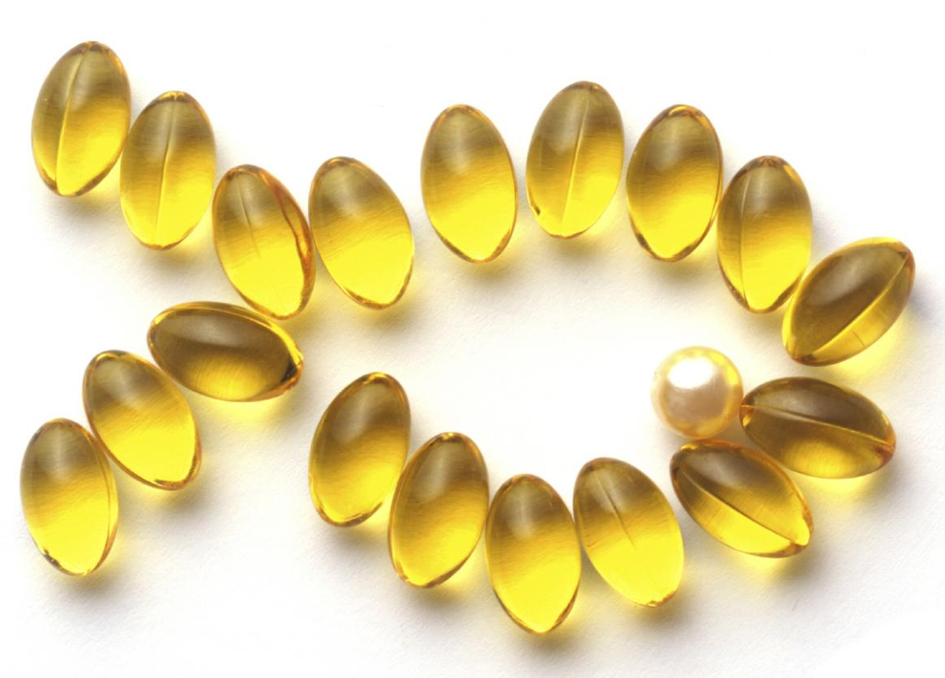
Microencapsulation of ω-3’s
Protect PUFAs from light and heat damage, suppress or retard oxidation
Many different types of encapsulating agents
Selection depends on adequate coating material to stabilize and protect oil from degradation during processing & storage
Methods include spray drying, freeze drying, spray-nozzle and double coating, etc.
Enhance bioavailability

Slide 11
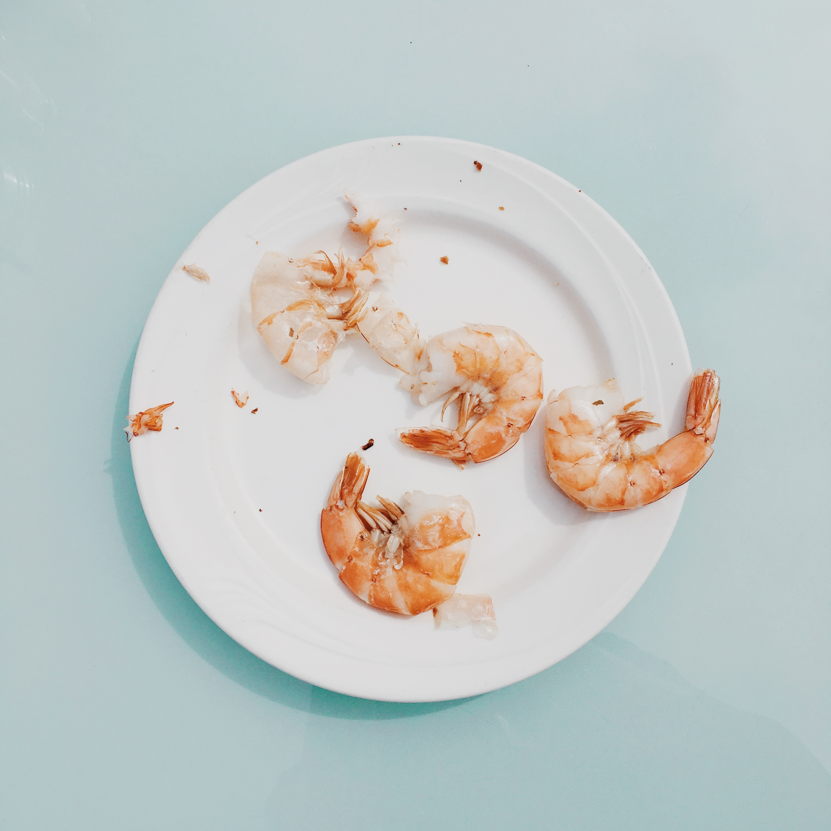
MAP and ω-3’s
Modified atmosphere processing has been studied as a method for preventing lipid oxidation in PUFAs
Several studies conducted utilizing different mixtures of oxygen, carbon dioxide, and nitrogen
Improved sensory attribute stability and prevention of lipid oxidation in several types of fish including:
Aqua-cultured mussels
Deepwater pink shrimp
Frozen and refrigerated shrimp
Seerfish
Swordfish

Slide 12
Takeaways
Lipid oxidation is a serious issue in PUFAs due to loss of nutritive value, sensory issues, and safety
ω-3’s are especially susceptible to lipid oxidation due to their degree of unsaturation
Fish oil is the most abundant source of ω-3’s with DHA and EPA being the most important
Concentration and type of PUFAs in fish depend on a variety of factors and possess many unique qualities
ω-3’s have a variety of beneficial effects on health
There has been an increased demand for products enriched with ω-3’s including dairy products, eggs, pastas, etc.
There are several ways to protect ω-3’s including inclusion of antioxidants, microencapsulation, and modified-atmosphere processing

Slide 13
References
Arab-Tehrany, E., Jacquot, M., Gaiani, C., Imran, M., Desobry, S., & Linder, M. (2012). Beneficial effects and oxidative stability of omega-3 long-chain polyunsaturated fatty acids. Trends in Food Science & Technology, 25(1), 24-33.
Cole, G. M., Lim, G. P., Yang, F., Teter, B., Begum, A., Ma, Q., ... & Frautschy, S. A. (2005). Prevention of Alzheimer's disease: Omega-3 fatty acid and phenolic anti-oxidant interventions. Neurobiology of aging, 26(1), 133-136.
Covington, M. B. (2004). Omega-3 fatty acids. Atlantic, 1(2.0).
Gonclalves, A. C., López‐Caballero, M. E., & Nunes, M. L. (2003). Quality changes of deepwater pink shrimp (Parapenaeus longirostris) packed in modified atmosphere. Journal of Food Science, 68(8), 2586-2590.
Kagami, Y., Sugimura, S., Fujishima, N., Matsuda, K., Kometani, T., & Matsumura, Y. (2003). Oxidative stability, structure, and physical characteristics of microcapsules formed by spray drying of fish oil with protein and dextrin wall materials. Journal of Food Science, 68(7), 2248-2255.
Kolanowski, W., & Laufenberg, G. (2006). Enrichment of food products with polyunsaturated fatty acids by fish oil addition. European Food Research and Technology, 222(3-4), 472-477.
Kotwal, S., Jun, M., Sullivan, D., Perkovic, V., & Neal, B. (2012). Omega 3 fatty acids and cardiovascular outcomes: systematic review and meta-analysis. Circulation: Cardiovascular Quality and Outcomes, 5(6), 808-818.
Peet, M., & Stokes, C. (2005). Omega-3 fatty acids in the treatment of psychiatric disorders. Drugs, 65(8), 1051-1059.
Schram, L. B., Nielsen, C. J., Porsgaard, T., Nielsen, N. S., Holm, R., & Mu, H. (2007). Food matrices affect the bioavailability of (n− 3) polyunsaturated fatty acids in a single meal study in humans. Food Research International, 40(8), 1062-1068.
Siska, G. (2018, December 12). Retrieved from https://www.pharmacytimes.com/publications/issue/2018/december2018/the-fish-oil-story
Serfert, Y., Drusch, S., & Schwarz, K. (2009). Chemical stabilisation of oils rich in long-chain polyunsaturated fatty acids during homogenisation, microencapsulation and storage. Food Chemistry, 113(4), 1106-1112.

