Slide 1
The Complexity of the development of Flavors and Colors in Black Tea Manufacturing, particularly withering of tea leaves
Presented by: Kevin B. Kiefer
Food Chemistry

Slide 2
Introduction – Tea
Tea is manufactured from young shoots of the tea plant Camellia sinensis¹
Tea is one of the most frequently consumed drinks in the world, next to water¹
Medical plant in India until the British arrived and introduced it as a drink for pleasure in the 19h century¹
India is the second largest producer next to China¹
75% total tea production includes black tea¹
Withering is a major processing step critical for the quality of black tea¹

Slide 3
Processing Stages
Plucking (picking)
Withering
Maceration
Rolling
Fermenting (oxidizing)
Drying (firing)
Major steps in tea manufacturing and the corresponding types of tea¹

Slide 4
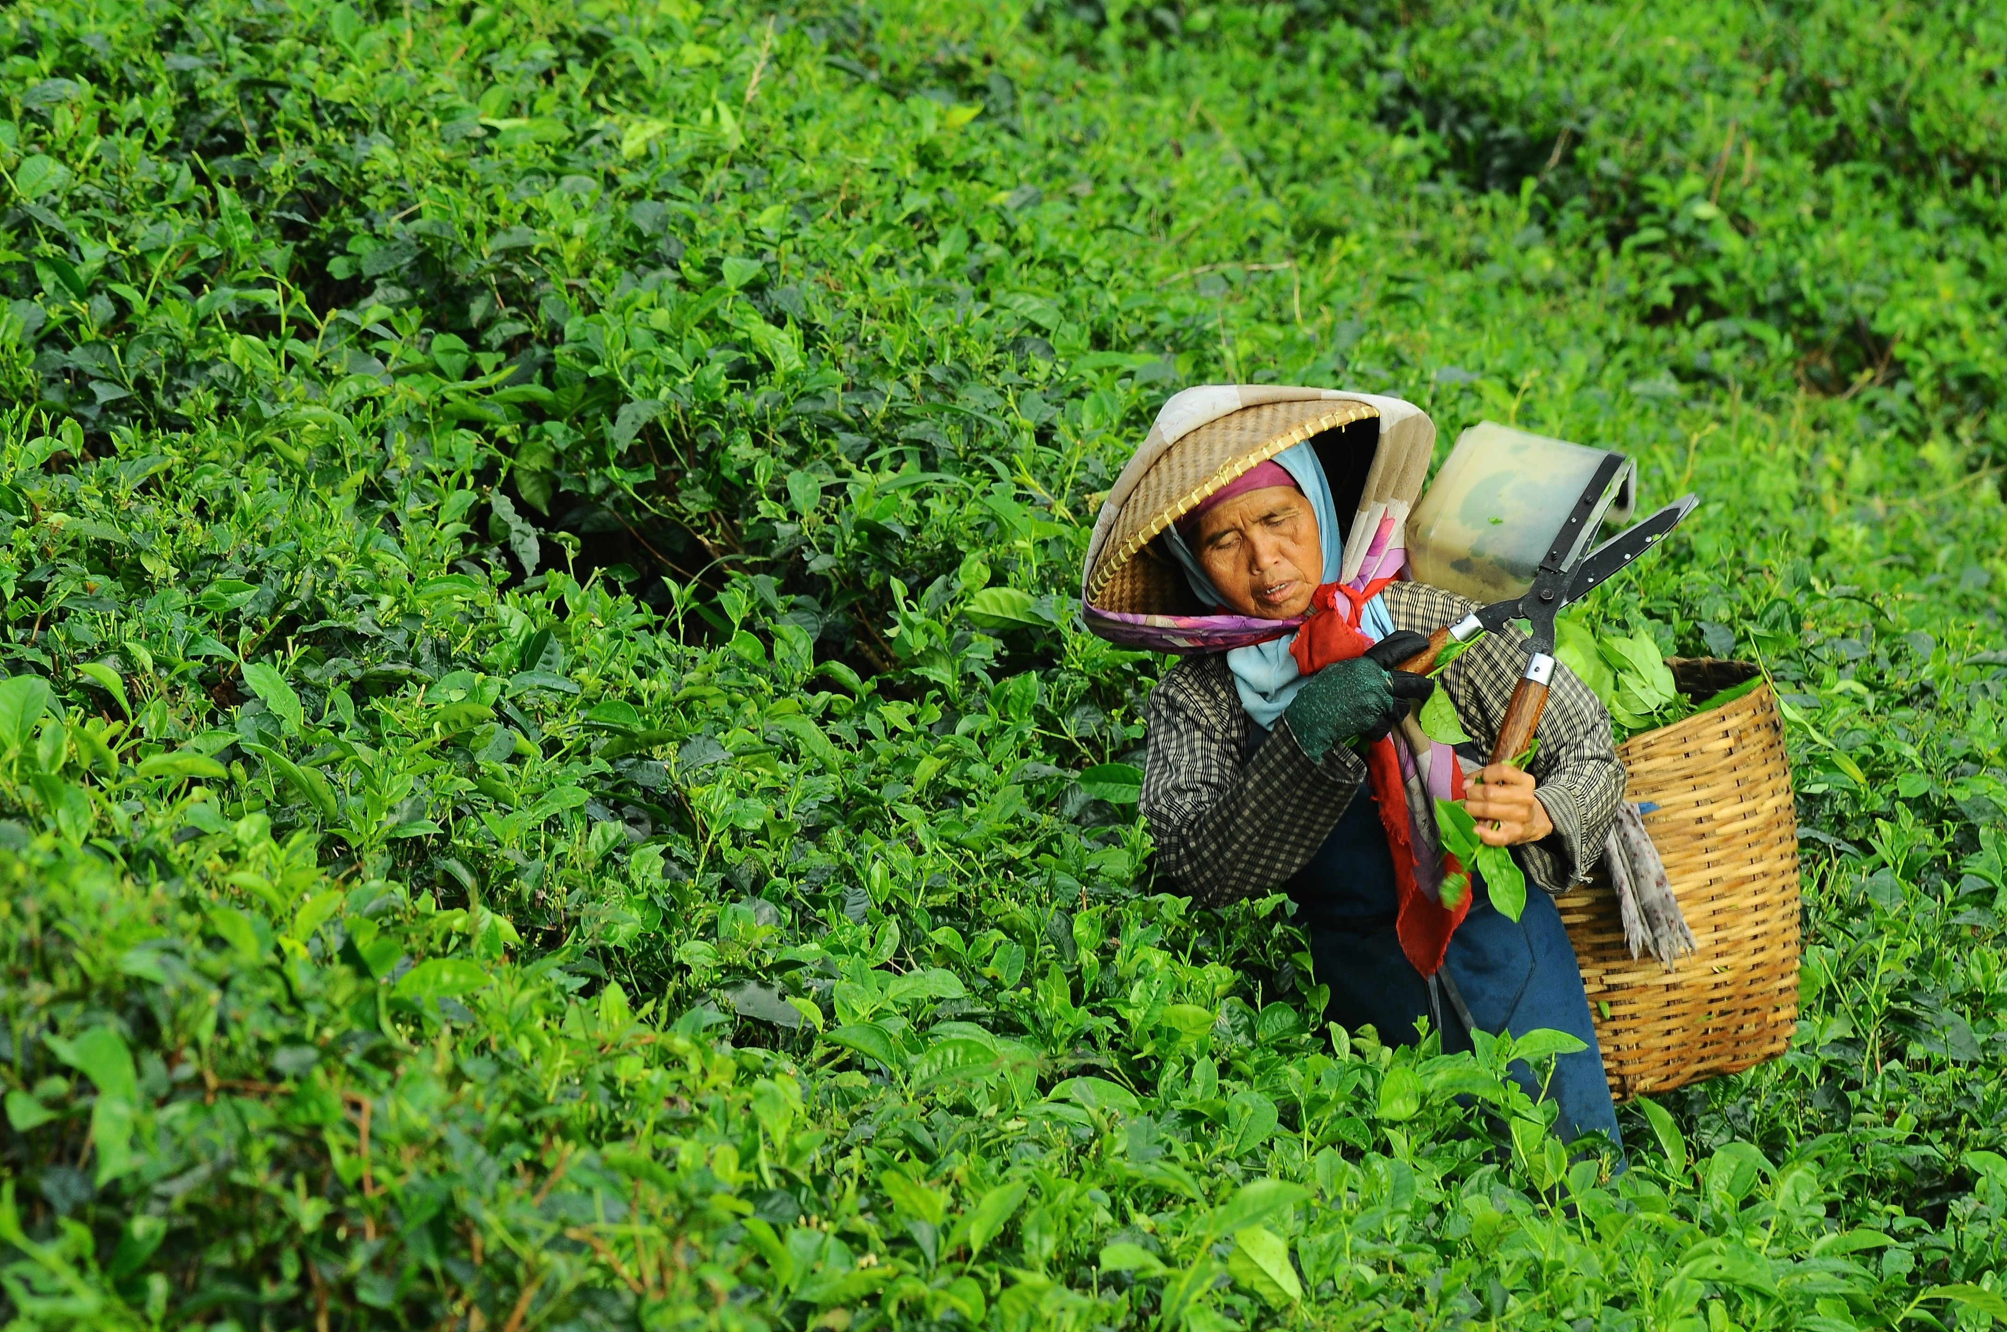
Plucking
Proper withering highly depends on plucking standards, leaf handling, and transportation¹
Compact leaf handling increases temperature¹
Decrease Theaflavin (TF) content¹
Less handling recommended to minimize cell damage¹

Slide 5
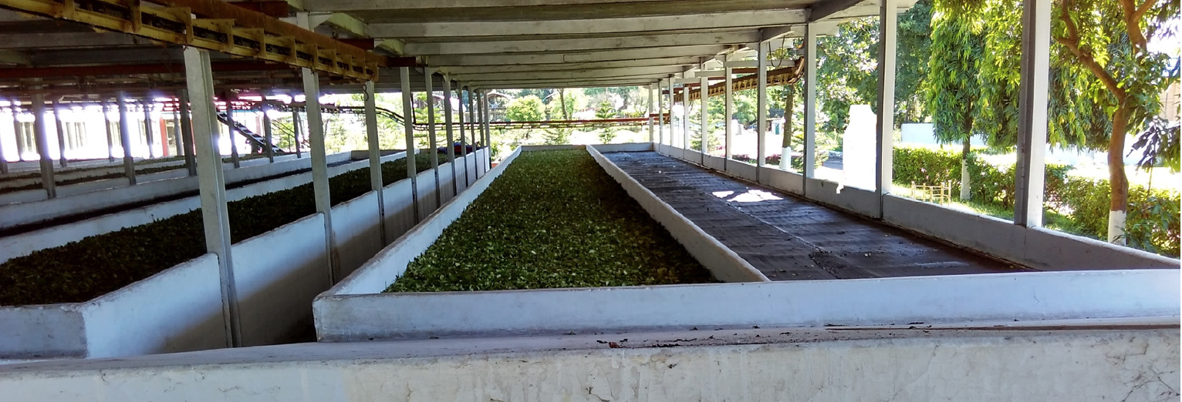
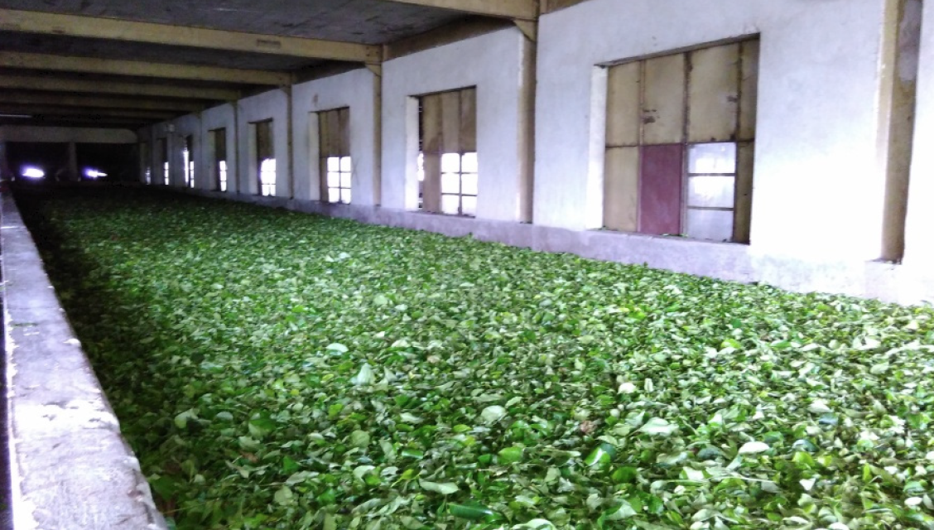
Withering
Partial dehydration
Physical wither¹
Shoots partially loose moisture dropping from around 70-80% to 60-70%, and turgid shoots become flaccid
Flexibility allow them to be twisted or rolled without becoming damaged
Chemical wither¹
Natural biochemical changes in tea leaves
Improves aroma, flavor, color, and other benefits in black tea
Open trough withering system
Enclosed trough withering system

Slide 6
Maceration Methods
Crush, tear, and curl (CTC)
Involves vertical maceration machine, horizontal maceration machine, or the rotorvane
Faster production
More affordable
Orthodox (traditional)
Involves using a roller or manual hand rolling
Preserves singular tea leaves
More authentic experience
Highly priced

Slide 7
Fermentation
Oxidizing, depends on proper withering (physical)
Excessive moisture content reduce aeration and temperature control resulting in uneven fermentation¹
Over-withering hinders enzymatic activities responsible for color, brightness, aroma, and other quality characteristics¹
Withering influences formation of black tea phenolics and volatile compounds²

Slide 8
Drying
Firing
Over-withering may cause leaves to burn during drying¹
Uneven withering will cause wet leaves to clump and stick on surface of the dryer bedplate¹

Slide 9
Proteins and Amino Acids
Protein levels reduced 1.2% during withering, increasing AA content involved in aroma formation²
Breakdown of protein by peptidase present in tea shoots¹
Simple sugars formed also react with amino acids forming Strecker aldehydes that can be reduced to alcohols that cause poor flavor in tea²
Amino acids like phenylalanine increase during withering to form phenylacetaldehyde that is reduced to alcohol, BUT improve tea aroma²
Amino acid composition varies with duration of withering²
Without moisture loss there is less amino acid formation²

Slide 10
Proteins and Amino Acids
Total free amino acids (%) of Camilla sinensis leaves at different withering times during black tea manufacturing⁴

Slide 11
Carbohydrates and Simple Sugars
Conversion of carbohydrates into simple sugars during withering¹
React with amino acids to form aroma compounds responsible for the flavor of black tea^{1,2}

Slide 12
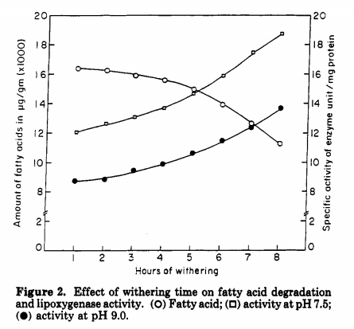
Lipids and Fatty Acids
Important for development of aroma compounds in black tea
Levels of saturated FAs decrease during withering (influence on flavor not known)
However, unsaturated FAs decrease during withering via lipid degradation causing oxidative cleavage to form aroma compounds²
catalyzed by lipoxygenase that is increased during withering
Strong grassy odor that not desirable for flavor
Effect of withering time on lipoxygenase activity⁵

Slide 13
Carotenoids
Carotenoids get degraded and volatile flavor compounds are formed during withering and fermentation¹
Degradation more significant during physical withering compared to chemical¹
Violaxanthin and neoxanthin reduced during withering
B-Carotene ad lutein reduced during fermentation
Degradation of carotenoids by flavanols (polyphenol)

Slide 14
Chlorophyll
High chlorophyll content usually a negative quality (grassy aroma)²
Conversion of chlorophyll to pheophytins during fermentation through acid hydrolysis contributing to black tea appearance^{1,2}
Withering decreased chlorophyll by 15% forming chlorophyllides^{1,2}
Chlorophyll
Pheophytins

Slide 15
Catechins and Enzyme Activity
Catechin content decreased during withering²
Catechins produce theaflavin (TF) and thearubigins (TR) in the presence of polyphenol oxidase (PPO)²
PPO activity decreases during withering as a result of moisture loss, but can be restored through rehydration, and activity of PPO is reduced by increased temperatures²
Non-enzymatic chemical oxidation of catechins during fermentation can also produce pigments similar to TR in black tea²
TF is responsible for the brisk and bright taste of black tea.
TF then reacts with more polyphenols to produce TR that is responsible for the distinctive body and color of black tea.

Slide 16
Work Cited
Deb, S., & Jolvis Pou, K. R. (2016). [A Review of Withering in the Processing of Black Tea]. 41. Retrieved from http://doi.org/10.5307/JBE.2016.41.4.365. doi:10.5307/JBE.2016.41.4.365
Tomlins, K. I., & Mashingaidze, A. (1997). Influence of withering, including leaf handling, on the manufacturing and quality of black teas — a review. Food Chemistry, 60(4), 573-580. Retrieved from http://www.sciencedirect.com/science/article/pii/S0308814697000356. doi:https://doi.org/10.1016/S0308-8146(97)00035-6
Ullah, M. R., Gogoi, N., & Baruah, D. (1984). The effect of withering on fermentation of tea leaf and development of liquor characters of black teas. Journal of the Science of Food and Agriculture, 35(10), 1142-1147. Retrieved from https://doi.org/10.1002/jsfa.2740351014. doi:10.1002/jsfa.2740351014
Jabeen, S., Alam, S., Saleem, M., Ahmad, W., Bibi, R., Hamid, F. S., & Shah, H. U. (2015). Withering timings affect the total free amino acids and mineral contents of tea leaves during black tea manufacturing. Arabian Journal of Chemistry. Retrieved from http://www.sciencedirect.com/science/article/pii/S1878535215000805. doi:https://doi.org/10.1016/j.arabjc.2015.03.011
Mahanta, P. K., Tamuli, P., & Bhuyan, L. P. (1993). Changes of fatty acid contents, lipoxygenase activities, and volatiles during black tea manufacture. Journal of Agricultural and Food Chemistry, 41(10), 1677-1683. Retrieved from https://doi.org/10.1021/jf00034a030. doi:10.1021/jf00034a030

Slide 17
Images
https://www.halmaritea.com/blog/know-the-type-of-preference-of-processed-black-tea-considering-ctc-and-traditional-way/
https://www.tiglobal.com/everest-dryer.html
https://waltersbay.com/products/maliboda-opa-ceylon-black-tea-loose-leaf
https://cdavies.wordpress.com/2009/01/27/simple-sugars-fructose-glucose-and-sucrose/
https://www.researchgate.net/figure/Schematic-representation-of-the-conversion-of-chlorophyll-a-to-pheophytin-through-acid_fig2_237825415
https://www.condair.co.uk/news/humidifiers-enhance-fermentation-at-bajrang-tea
https://www.sciencedirect.com/science/article/pii/S221345301500018X

