Slide 1
Substituting Fats in Foods
Jeff Colburn

Slide 2
Why would you do such a thing???
Not considered healthy (public perception)
Increases cholesterol
How about cost?
Harvard Health, 2018

Slide 3
Fat Benefits
Energy and Essential fatty acids
liposoluble vitamins (A,D,E, and K)
Satiety
body temperature constant
So what do we shoot for? What is healthy?
Ospina-E et. al. 2012

Slide 4
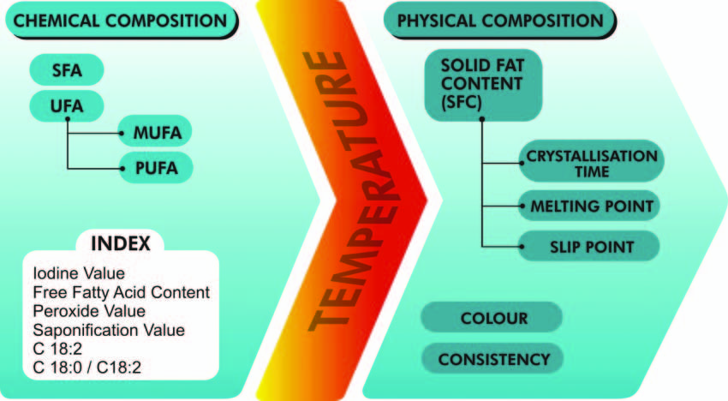
Quality Fat in Foods
Defining a quality fat is not the simplest thing to do
Ospina-E et. al., 2012

Slide 5
Substitutions → Fat Replacers (Akoh, 1998)
Come in many forms and structurally may be considered fats, proteins, or carbohydrates
Two categories to focus on
  Fat Mimetics
  Fat Substitutes

Slide 6
Fat Mimetics
Mimic physical and organoleptic triglycerides
  Not capable of replacing fat 1:1
Problems
  Caramelization and denaturalization at high temps
  Lacking lipid flavor
Numerous combinations have been put together

Slide 7
Fat Substitutes
Macromolecules, physically and chemically resemble triglycerides (can be substituted at 1:1)
Classified as liquid or plastics
  Liquids equivalent to use of soft fats
  Plastics similar to hard fats
  Ospina-E et al. 2012

Slide 8
Processes For Creation
Fat mimetics are carbohydrates and proteins
  Require hydration in order to serve as a fat replacer
Fat substitutes come from conventional fatty acid bases, chemically or physically modified
Plastics are created through chemical or enzymatic alteration (partial hydrogenation, interesterification)
Ospina-E et al. 2012

Slide 9
How Do They Add Up?
Art form combined with chemistry
Combinations of lower animal derived fat content with fat replacers
Traditional objective measures do not equal success (Consumer perception/sensory evaluation is king)
No one combination is a cure all
Ospina-E et al. 2012

Slide 10
References
Harvard Health Publishing (2018). The Truth About Fats: The Good, The Bad, and the In-between. Retrieved from https://www.health.harvard.edu/staying-healthy/the-truth-about-fats-bad-and-good
Ospina J., Sierra A., Ochoa, O., Perez-Alvarez J., and Fernandez-Lopez J. (2012). Substitution of Saturated Fat in Processed Meat Products: A Review. Critical Reviews in Food Science and Nutrition, v. 52, 113-122.

