Slide 1
Managing Oxidation in Food Emulsions
Eric Hamilton
NFSC 605

Slide 2
What is an emulsion?
“Emulsions are colloidal two-phase systems, in which a liquid is dispersed in another liquid of different composition, the second liquid forming the continuous phase. The dispersed phase is also called internal phase, and the continuous phase is referred to as the external phase” (Ugalde-Benítez, 2012)
Two-phase systems traditionally classified with two well known liquids:
Oil
Water
Oil and water two-phase emulsions classified as “oil-in-water” or water-in-oil”
Lipids present in the oil phase can create challenges in product quality and toxic substances in food emulsions

Slide 3
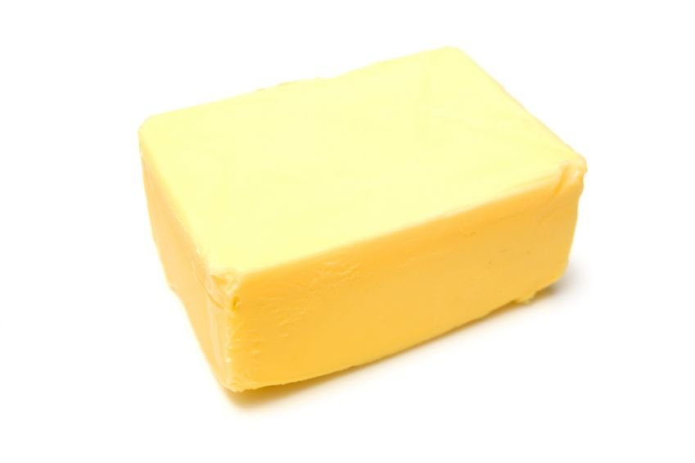
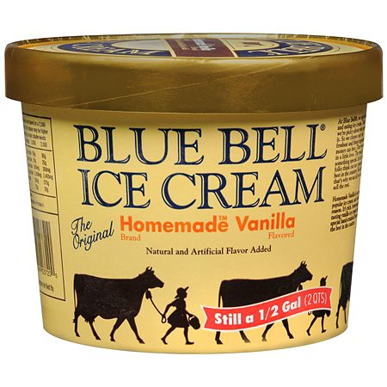
Examples of emulsions
Oil-in-Water
Water-in-Oil
Oil and Air-in-Water
Figure 1. DairyPure 2% milk – gallon. Retrieved from
https://www.amazon.com/DairyPure-Reduced-Milk-Pasteurized-Gallon/dp/B00CIJAE0C
Figure 2. Margarine block. Retrieved from
https://www.culinarynutrition.com/4-ways-margarine-is-bad-for-your-heart/
Figure 3. Blue Bell Ice Cream© Homemade Vanilla.
Retrieved from https://www.walgreens.com/store/c/blue-bell-ice-cream-homemade-vanilla/ID=prod6083490-product

Slide 4
Lipids in an emulsion
Three regions to consider when looking at lipid droplets in an emulsion:
Interior phase – i.e. oil
Continuous/Aqueous phase – i.e. water
Interfacial membrane – region that is covering each droplet (emulsifying agent)
Figure 4. The droplet interior, the interfacial region and the aqueous phase in a
oil-in-water emulsion. McClements, D. J. and Decker, E. A. (2000). Lipid Oxidation in Oil-in-Water Emulsions: Impact of Molecular Environment on Chemical Reactions in Heterogeneous Food Systems. J. Food Sci. 65(8): 1270-1282.
Notes:
Lipid Oxidation in Oil-in-Water Emulsions:
Impact of Molecular Environment on Chemical
Reactions in Heterogeneous Food Systems
D.J. M
C
C
LEMENTS
AND
E.A. D
ECKER

Slide 5
Lipids in an emulsion
Different fatty acid structures in lipids present in emulsions:
Unsaturated (mono-unsaturated and poly-unsaturated)
Characterized by at least one double bond in fatty acid structure
Examples: Linoleic Acid (18:2) and linolenic acid (18:3)
Less energy needed to break bonds and longer chains
Saturated
Characterized by no double bonds in fatty acid structure
Examples: Stearic Acid (18:0) and Palmitic (16:0)
Linoleic Acid (18:2)
Figure 5. Linoleic Acid structure. Retrieved from https://commons.wikimedia.org/wiki/File:Linoleic_acid_shorthand_formula.PNG
Stearic Acid (18:0)
Figure 6. Stearic Acid structure. Retrieved from https://commons.wikimedia.org/wiki/File:Stearic_acid_shorthand_formula.PNG.

Slide 6
Lipid oxidation in emulsions
Unsaturated fatty acids are of main concern regarding lipid oxidation in emulsions
Three pathways for unsaturated fatty acid oxidation to occur (Sun et al., 2011):
Photo-oxidation (i.e. light)
Autoxidation (i.e. excited oxygen states)
Enzyme-catalyzed (i.e. enzymatic browning – phenolases)
Undergoing lipid oxidation (peroxidation) leads to the production of free radicals
Most commonly generated via bond cleavage; metal ions
Peroxidation reactions may also occur from non-radicals
i.e. Singlet-oxygen

Slide 7
Free-radical formation
Figure 6. Interactions of transition metals and lipids into lipid radicals and nonradical products. D. J. and Decker, E. A. (2000). Lipid Oxidation in Oil-in-Water Emulsions: Impact of Molecular Environment on Chemical Reactions in Heterogeneous Food Systems. J. Food Sci. 65(8): 1270-1282.

Slide 8
Lipid oxidation in emulsions
Lipid oxidation lead to several primary and secondary compounds:
Primary: hydroperoxides
Can break into secondary compounds
Secondary: aldehyde, ketone, organic acid, epoxide, or polymers
These compounds can lead to quality-related issues in food items that accelerate in lipid oxidation over time
Rancid flavors
Off-color
Toxic compounds

Slide 9
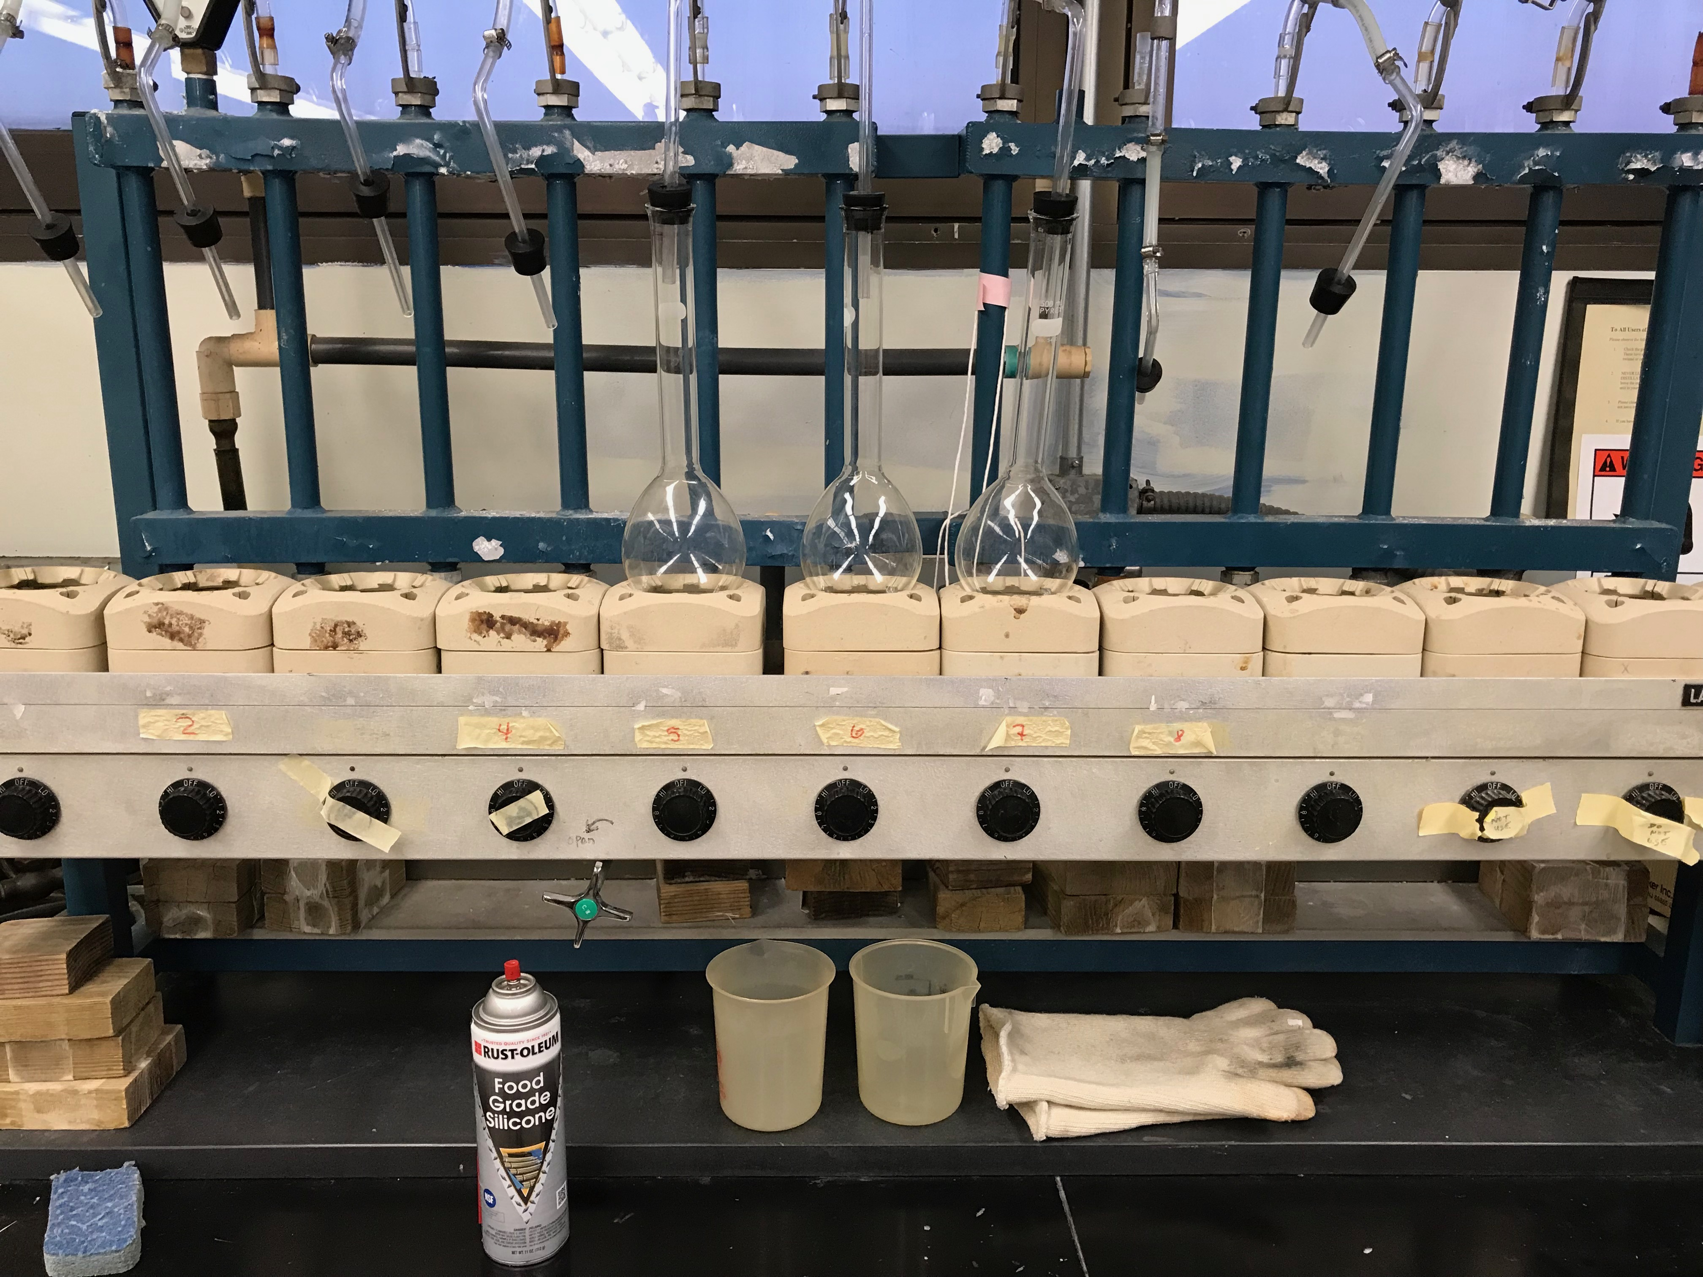
Analyzing oxidative stability
Tests are available to analyze both primary and secondary oxidation products (Sun et al., 2011)
Primary product analyses:
Peroxide Values (PV)
Iron Thiocyanate Method
Active Oxygen Method
Secondary product analyses:
Thiobarbituric Reactive Substances (TBARS)
Anisidine Value (AnV) Test
Acid value
Figure 7. Heating coils and distillation units used for TBARS. KLCT 329. Dr. Wes Osburn Laboratory. Texas A&M University.

Slide 10
Managing oxidation in emulsions
Managing the use of raw materials and the environment of emulsions can lead to prolonging initiation of oxidation
Vacuum packaging – removal of oxygen from contacting food product
Purity of raw materials
Oxidation can be unstable or stable based upon properties of the emulsion:
Emulsifying agents
Lipid droplet characteristics
Lipid chemical structures (saturated vs unsaturated)
Interactions with aqueous phase
Ingredients can be added to emulsions that chelate transitioning metal ions
Antioxidants

Slide 11
Interfacial membrane management
The interfacial membrane can enhance the stability of an emulsion by becoming a barrier between pro-oxidants and lipids (Sun et al., 2011)
Example: an increase in the interfacial membrane thickness increase emulsion oxidation stability (Donnelly et al., 1998; Kabalnov, 1994)
Interfacial membranes can be compromised of proteins or other small emulsifiers
Sausages – meat proteins (myofibrillar and sarcoplasmic)
Mayonnaise – egg yolk
Chocolate – lecithin

Slide 12
Interfacial membrane management
Different emulsifiers have different effects on emulsion stability
Example: Fomuso et al., 2002
In menhaden oil-caprylic acid oil-in-water emulsions, there were differences observed between high or low emulsifier agent %
High % = lower oxidation rates, and vice versa
Figure 8. Changes in TBARS with time in structured lipid emulsions at 0.25 and 1% emulsifier concentrations. Fomuso, L. B., Corredig, C., and Akoh, C. C. (2002). Effect of Emulsifier on Oxidation Properties of Fish Oil-Based Structured Lipid Emulsions. J. Agric. Food Chem. 50:2957-2961.

Slide 13
Lipid droplet management
Droplet characteristics can be managed in order to decrease oxidation rates
Droplet concentration
Droplet size
Droplet charge
Droplet physical state
Droplet concentration can vary from a fraction to 80% (Clements and Decker, 2000)
Roozen et al. (1994a,b) studied oxidation of linoleic acid in colloidal aqueous emulsions
Tested linoleic acid solubilized in nonionic surfactant micelles with or without the presence of inert oil droplets at low concentrations
Study found that rate of oxidation of linoleic acid decreased as concentration of inert oil droplets increased
Reasoning: Some of the linoleic acid moved from the surfactant micelles to the interior of the inert oil droplets, and therefore inaccessible to pro-oxidants

Slide 14
Lipid droplet management
Droplet Size
Can vary from 2 µm to 100 µm (Clements and Decker, 2000)
Cream liquors vs salad dressings
Generally thought that as lipid droplet size decreases (surface area increases), oxidation rates increase (Gohtani et al., 1999)
BUT, must take into account amount of reactants and where reactants are located relative to droplet locations
Droplet charges
Negatively charged droplets will attract metal ions, therefore accelerating lipid oxidation rates
Emulsifiers can be used to give droplets a positive charge, therefore electrostatically repelling metals (Clements and Decker, 2000)

Slide 15
Lipid droplet management
Droplet physical characteristics
Lipid droplets oxidation rates differ between liquid and solid state
Lipids in the liquid state have a much faster oxidation rate than lipids in the solid state
Room temperatures vs refrigerated temperatures
Lipid chemical structures can be altered in order to have more oxidation stability
Full hydrogenation
Blending solids and liquid fats/oils
BUT, need to consider: purity of materials blended together?
Inter-esterification (chemical or enzymatic)
Fractionation

Slide 16
Aqueous phase management
Interactions with aqueous phase
Other ingredients in the aqueous phase can impact the oxidation rate of food emulsions
Examples: salt, sugar, and emulsifiers
Salt has been studied and shown to be a pro-oxidant (Mei et al., 1998)
Sugar has shown to be capable of scavenging free radicals and delaying lipid oxidation (Chatterjee et al., 2007)
Emulsifiers (Paraskevopoulou et al., 2007)
Figure 9. Changes in peroxide values over time in virgin olive oil samples prepared as control, and olive oil-lemon juice emulsions prepared with polysaccharides, gum arabic and propylene glycol alginate emulsifiers. Paraskevopoulou, D., Boskou, D., and Paraskevopoulou, A. (2007). Oxidative stability of olive oil–lemon juice salad dressings stabilized with polysaccharides. Food Chem. 101:1197-1204.

Slide 17
Antioxidants in emulsions
Antioxidants can work against lipid oxidation in two ways (Sun et al., 2011):
Protecting targeted lipid droplets from initiators (Primary antioxidants)
Stalling propagation phase (Secondary Antioxidants)
Antioxidants can have multiple functions
Important to consider polar vs nonpolar antioxidants
Nonpolar antioxidants most effective for emulsified foods
Common primary antioxidants:
Butylated hydroxyanisole (BHA)
Propyl gallate (PG)
Tocopherols
Common secondary antioxidants:
Citric acid
Ascorbic acid
Ethylenediaminetetraacetic acid (EDTA)
Figure 10. Reactions of antioxidants and free radical lipids. Chaiyasit W, Elias RJ, McClements DJ, Decker EA. 2007. Role of physical structures in bulk oils on lipid oxidation. Food Sci. Nutr. 47:299 – 317.

Slide 18
Conclusions
Emulsions are across several food categories and are widely used in the food industry
Lipid characteristics play a key role in product quality and shelf-life
Lipid oxidation is a continuous concern for the food industry, and more research regarding how to prevent or further retard initiation is a priority
There are several factors that can affect lipid oxidation including lipid properties, environmental factors, and other ingredients used in emulsified food products

Slide 19
References
Chaiyasit W, Elias RJ, McClements DJ, Decker EA. (2007). Role of physical structures in bulk oils on lipid oxidation. Food Sci. Nutr. 47:299 – 317.
Chatterjee, S., Niaz, Z., Gautam, S., Adhikari, S., Variyar, P. S., and Sharma, A. (2007). Antioxidant activity of some phenolic constituents from green pepper (Piper nigrum L.) and fresh nutmeg mace (Myristica fragrans). Food Chem. 101(2): 515–523.
Donnelly, J. L., Decker, E. A., and McClements, D. J. (1998). Iron-catalyzed oxidation of menhaden oil as affected by emulsifiers. J. Food Sci. 63(6): 100-997
Fomuso, L. B., Corredig, C., and Akoh, C. C. (2002). Effect of Emulsifier on Oxidation Properties of Fish Oil-Based Structured Lipid Emulsions. J. Agric. Food Chem. 50:2957-2961.
Gohtani S, Sirendi M, Yamamoto N, Kajikawa K, Yamano Y. (1999). Effect of droplet size on oxidation of docosahexaenoic acid in emulsion system. J Disp Sci. Tech. 20:1319–1325.
Kabalnov, A. (1994). Can micelles mediate a mass transfer between oil droplets. Langmuir. 10:680-684.
Mancuso JR, McClements DJ, Decker EA. (1999a). The effects of surfactant type, pH, and chelators on the oxidation of salmon oil-in-water emulsions. J Ag Food Chem. 47:4112–4116.
McClements, D. J. and Decker, E. A. (2000). Lipid Oxidation in Oil-in-Water Emulsions: Impact of Molecular Environment on Chemical Reactions in Heterogeneous Food Systems. J. Food Sci. 65(8): 1270-1282.
Mei, L., McClements, D. J., Wu, J. N., and Decker, E. A. (1998). Iron-catalyzed lipid oxidation in emulsion as affected by surfactant, pH and NaCl. Food Chem. 61(3): 307–312.
Paraskevopoulou, D., Boskou, D., and Paraskevopoulou, A. (2007). Oxidative stability of olive oil–lemon juice salad dressings stabilized with polysaccharides. Food Chem. 101:1197-1204.
Roozen JP, Frankel, EN, Kinsella JE. (1994a). Enzymic and autoxidation of lipids in low fat foods: model of linoleic acid in emulsified hexadecane. Food Chem. 50:33–38.
Roozen JP, Frankel EN, Kinsella JE. (1994b). Enzymic and autoxidation of lipids in low fat foods: model of linoleic acid in emulsified triolein and vegetable oils. Food Chem. 50:39–43.
Sun, Y. E., Wang, W. D., Chen, H. W., and Li, C. (2011). Autoxidation of Unsaturated Lipids in Food Emulsions. J. Food Sci. 51:453-466.
Ugalde-Benítez, V. (2012). Meat emulsion. In Y. H. Hui (Ed.), Handbook of meat and meat processing (pp. 447–456). Boca Raton, FL: CRC Press

Slide 20
Thank you!
Questions?

