Slide 1
Shortenings in Foods
Corinne Kowald
4/9/2019

Slide 2
Background
Originally referred to lard, but now includes margarine and hydrogenated vegetable oil products such as Crisco
Prior to the invention of margarine in 1814 (Freeman 2012), the three main fats used in foods were
Lard (rendered and clarified pig fat)
Butter
Pressed vegetable oils (i.e. olive oil)
In 1911, Proctor and Gamble released Crisco, a hydrogenated vegetable shortening (Ghotra et al., 2002)

Slide 3
Uses
In baked goods:
Improve texture and mouthfeel
Lubricate gluten to improve structure
Can also be used in fillings and frostings
In fried foods:
Provide moisture barrier
Even heat distribution
Margarine is normally used as a spread
Depending on the use, the solid:liquid phases, oxidative stability, and plasticity of the shortening will vary
https://filmfoodsafari.wordpress.com/2014/07/21/fried-chicken-the-help/

Slide 4
Changes in % Solids
Ghotra et al., (2002)

Slide 5
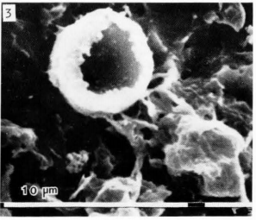
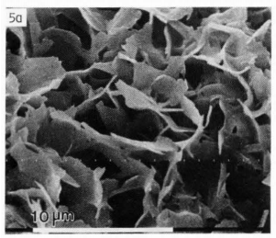
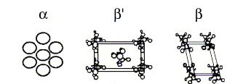
Tempering
Crystallization
Fat crystallization takes place via heating (tempering), hydrogenation, or dry fractionation
Long-chain TAGs can have multiple polymorphisms, which can influence crystallization
Three relevant polymorphisms:
Himawan et al., 2006
Fat crystals in butter (left) and all-purpose shortening (right)
Juriaanse & Heertje, 1986
Notes:
Interpolymorphic transitions are always irreversible
For example, chocolate has 6 polymorphs, and only 1 (form 5, beta 2) is desirable
Beta has the highest melting point of the 3

Slide 6
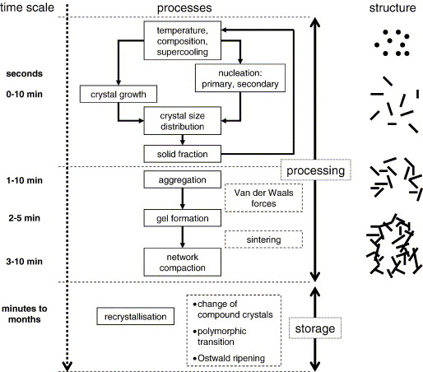
Crystallization
Crystallization is a process during which fats are broken down and redistributed into a crystalline network
Crystal size distribution is a crucial step in the process
Crystals larger than a couple of microns are detectable in the mouthfeel of the product
Sintering is the formation of bridges between individual crystals
Usually increases the hardness of the product
Himawan et al., 2006
Notes:
Steps are not always chronological; nucleation can still occur during recrystallization a

Slide 7
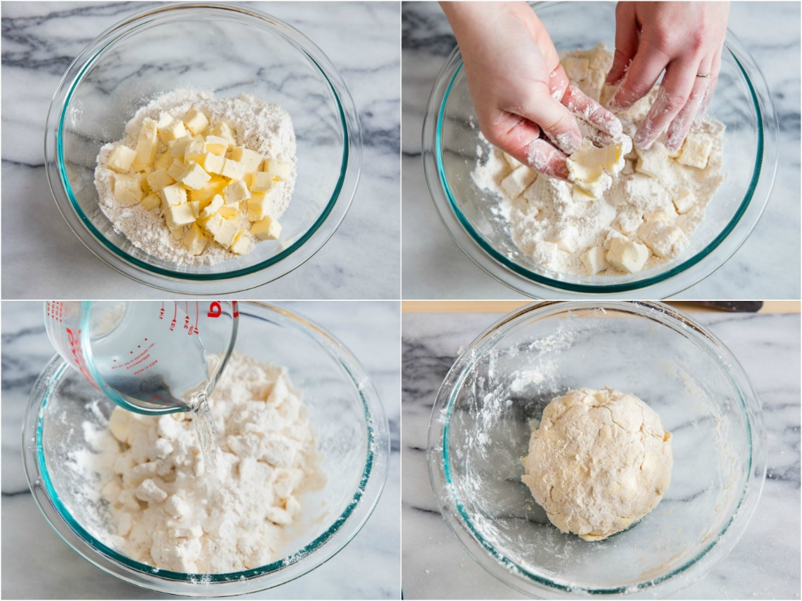
Case Study: Pie Crusts
Pie crusts achieve their signature flakiness via large lumps of butter or shortening with a grainy structure rolled into the dough
With shortening, the higher melting point allows for easy incorporation into the dough
The advantage of using shortening over butter is that it will not melt as it’s being rolled into the dough
It will also act as a better coating for the gluten
The disadvantage is the lack of buttery flavor
https://www.seriouseats.com/2018/11/pie-dough-troubleshooting.html
Notes:
Shortening impedes gluten formation for a “short” dough; i.e. more shortening=“shorter” dough

Slide 8
Case Study: Frying Shortening
The types of shortening used for frying can vary widely depending on the product
The moisture content and fat content of the product as well as the smoke point of the oil contribute to the selection
For example, doughnuts require a highly stable shortening with a high melting point so that the oil uptake is minimized
Potato chips need a frying shortening with low solids content as the final product will already comprise of almost 50% fat

Slide 9
Industry Challenges
Partial hydrogenation was the go-to method for many years, which is no longer an acceptable process
Many companies are now using fully hydrogenated soybean and palm oil to make solid shortenings like Crisco
Dry fractionation has also made a slight resurgence (it is not a hydrogenation process) but is considered inefficient and time consuming
Many consumers are moving away from saturated fats in their diets

Slide 10
Works Cited
References:
Freeman, I. P. (2012). Margarines and Shortenings. Ullman's Encyclopedia of Industrial Chemistry
Ghotra, B. S., Dyal, S. S., & Narine, S. S. (2002). Lipid Shortenings: a review. 35, 1015-1048.
Himawan, C., Starov, V. M., & Stapley, A. G. F. (2006). Thermodynamic and kinetic aspects of fat crystallization. Advances in Colloid and Interface Science, 122(1), 3-33.
Juriaanse, A. C., & Heertje, I. (1988). Microstructure of Shortenings, Margarine, and Butter- A Review. 7(2).
Sato, K. (2001). Crystallization behaviour of fats and lipids — a review. Chemical Engineering Science, 56(7), 2255-2265.

