Slide 1
Non-enzymatic Browning
Maillard reaction

Slide 2
INTRODUCTION
    Reducing sugars Brown colors
Desirable
Undesirable
    Reducing sugars + Amino Acids
Free amino acid or
Free amino group of a protein
MAILLARD REACTION
Notes:
Desirable: browning of the crust of the bread or coffee roasting or onions frying. Undesirable (heating or storage conditions): stored condensed milk, or dry vegetables

Slide 3
INTRODUCTION: Maillard Reaction
Reducing sugar + Amine
Glycosylamine
Fig. 1: Conversion of the Armadori products into HMF

Slide 4
INTRODUCTION
Keep in mind:
The type of amino acid will determine the resulting flavor
Heat is usually required
Flavors:
Meat roasting
Bread crusts
Chocolate, coffee, cocoa
Caramels

Slide 5
OBJECTIVES
    To gain a better understanding of non-enzymatic browning reactions and their role in food products.
    To investigate the influence of substrate type on the rate of the Maillard reaction and establish the effect of pH on Maillard browning reaction rates.

Slide 6
Lab1: MATERIALS AND METHODS
  Volumetric flasks (50, and 100 mL)
  Pipettes (10 mL)
  Beakers (100 and 50 mL)
  Spectrophotometer
  Water bath
  Screw-cap test tubes with caps
  Phosphate buffers:
  pH: 4.5 (low) and pH 8.5 (high) by mixing 66.7mM KH2PO4 and 66.7 mM Na2HPO4 - PREPARED

Slide 7
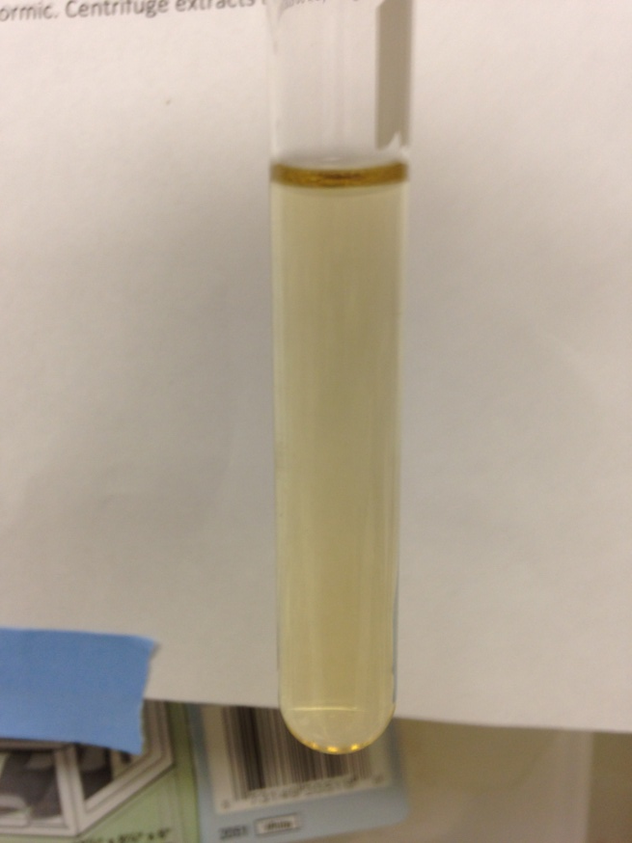
Lab1: MATERIALS AND METHODS
Sugars | Amino Acids | pH | Time
Glucose | Glycine | 4.5 | 5
Fructose | Glutamine | 8.5 | 10
Sucrose |  |  | 20
Mixtures
Prepare a pH 4.5 buffer blank for the spectrophotometer

Slide 8
Lab 2: Visual observations
Time to play:
Select any type a sugar and amino-acid combos.
Try to create your own flavors!
Try to create:
  A desirable flavor
  A nasty flavor – Which AA would lead to that?
  Reversing or inhibiting the reaction

Slide 9
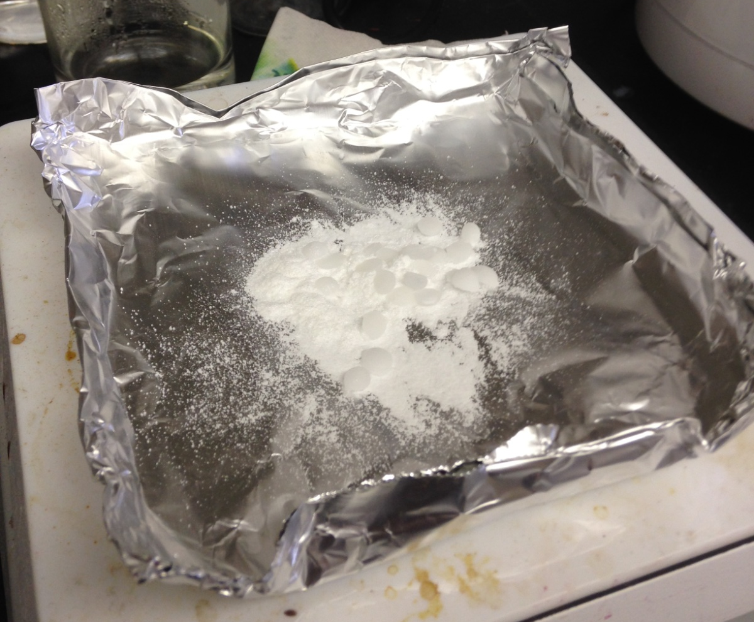
Lab 2: Visual observations

Slide 10
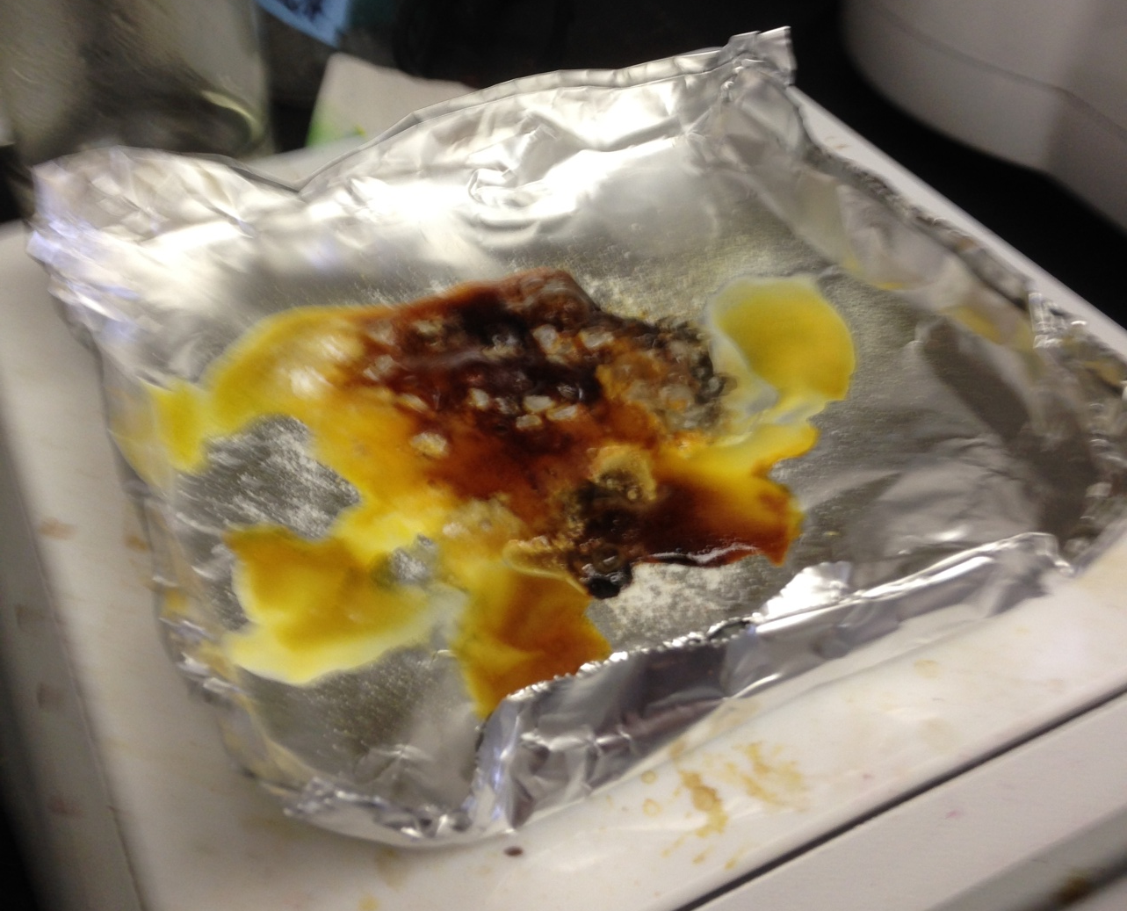
Lab 2: Visual observations

