Slide 1
ENZYME-CATALYZED REACTIONS
Case of Polyphenoloxidase

Slide 2
INTRODUCTION
Browning:
      Fruits and vegetables
Enzymatic
Non-enzymatic
Sensory properties
- Color
- Flavor
Oxidation of phenolic compounds
Bad
Good

Slide 3
INTRODUCTION: PPO
Polyphenoloxidase (PPO): Enzyme that catalyze browning reaction
  Examples: Apples, avocados, lettuce, potatoes
The reaction:
Cu⁺
Quinones
Insoluble brown Polymers

Slide 4
INTRODUCTION
What factors determine rate of enzymatic browning?
  Concentration of available PPO
  Concentration of Phenolics
  pH
  Temperature
  Oxygen availability

Slide 5
INTRODUCTION
How can we control the reaction?
  Ascorbates, bisulfites, thiols --- Reducing agents, Reduce quinone formation
  EDTA, Oxalis acid, Citric Acid --- Chelators
  Citric acid, malic, phosphoric acids --- Change pH of solution

Slide 6
OBJECTIVES
    To measure enzymatic activity and determine concentration dependence of an enzyme-catayzed reaction rate on substrate concentration
    Evaluate influence of inhibitors

Slide 7
MATERIAL
    Potato filtrate: being prepared
    Substrate: 20mM catechol dissolved in buffer
    5mM ascorbic acid dissolved in buffer
Method 1: Rate of Enzyme
    Obtain a test tube rack and small test tubes: everybody will do a duplicate of reactions!!!
    Follow table order

Slide 8
Method: Rate of Enzyme
Material | Volumes necessary
Catechol (mL) | 0.00 | 0.05 | 0.10 | 0.20 | 0.40 | 0.80 | 1.6
Phosphate buffer (mL) | 3.00 | 2.85 | 2.8 | 2.70 | 2.50 | 2.10 | 1.30
Potato filtrate (mL) | 0.10 | 0.10 | 0.10 | 0.10 | 0.10 | 0.10 | 0.10
Total volume (mL) | 3.00 | 3.00 | 3.00 | 3.00 | 3.00 | 3.00 | 3.00
Lab Group # | 1 to 7 | 1 to 7 | 1 to 7 | 1 to 7 | 1 to 7 | 1 to 7 | 1 to 7
In duplicates!!!!!
    Prepare reaction mixtures as shown
    Don’t add the filtrate yet!!! - This step will be done with everybody, as we will read abs in microplate reader!!!

Slide 9
Method: Rate of Enzyme
    After everybody has mixed components, add 0.1 mL to microplate.
    The 0.1 mL potato filtrate will be added all at once – on everybody’s plate!!!!
    Prepare spectrophotometer
      Read blank (no enzyme).
      The wavelength is 395 nm. Only one blank (in duplicate) is needed for the entire series of assays.
    4. Continuous assays: Record absorbance readings every 10-20 seconds/ or minutes, depending on the rate of the reaction using the microplate reader.

Slide 10
Method 2: Impact of Inhibitor
    Effect of Ascorbic acid on PPO activity
    Each group will assay phenol oxidase activity in the presence of various concentrations of ascorbic acid, in duplicate
Material | Volume needed (mL)
Catechol (mL) | 2.00 | 2.00 | 2.00 | 2.00 | 2.00 | 2.00 | 2.00
Phosphate buffer (mL) | 0.90 | 0.88 | 0.86 | 0.82 | 0.74 | 0.58 | 0.26
Ascorbate (mL): | 0.00 | 0.02 | 0.04 | 0.08 | 0.16 | 0.32 | 0.64
Potato filtrate | 0.10 | 0.10 | 0.10 | 0.10 | 0.10 | 0.10 | 0.10
Total volume (mL) | 3.00 | 3.00 | 3.00 | 3.00 | 3.00 | 3.00 | 3.00
Lab Group # | 8 to 14 | 8 to 14 | 8 to 14 | 8 to 14 | 8 to 14 | 8 to 14 | 8 to 14
    Repeat same steps as for previous assays
    Read on microplate reader

Slide 11

Results: Interpreting
    Plot the change in absorbance as a function of time, and determine the slope:
$\left[E\right]$+ $\left[S\right]$ $\left[ES\right]$ $\left[E\right]$ + $\left[P\right]$
SLOPES:
- Abs/time
SLOPES =
Rate
Velocity

Slide 12
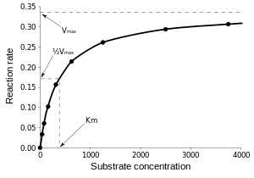


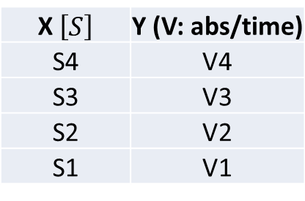
Results: Interpreting
Slopes = Velocity – Plot a graph:
X $\left[S\right]$ | Y (V: abs/time)
S4 | V4
S3 | V3
S2 | V2
S1 | V1
    Michaelis-Menten
$$V= V_{Max} . \frac{\left[S\right]}{K_{M}+\left[S\right]}$$
    Linearize
$$\frac{1}{V}= \frac{1}{\left[S\right]}\frac{K_{M}}{V_{Max}}+\frac{1}{V_{Max}}$$

Slide 13
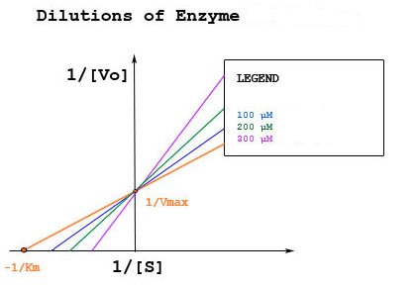
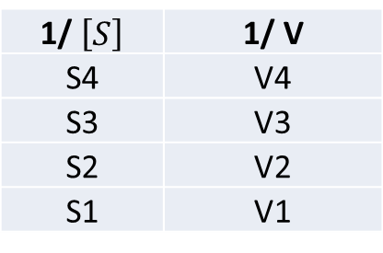
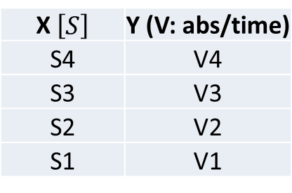

Results: Interpreting
How can we work with this data?
X $\left[S\right]$ | Y (V: abs/time)
S4 | V4
S3 | V3
S2 | V2
S1 | V1
1/ $\left[S\right]$ | 1/ V
S4 | V4
S3 | V3
S2 | V2
S1 | V1
    Michaelis-Menten
    Lineweaver-Burlee
$$\frac{1}{V}= \frac{1}{\left[S\right]}\frac{K_{M}}{V_{Max}}+ \frac{1}{V_{Max}}$$

Slide 14



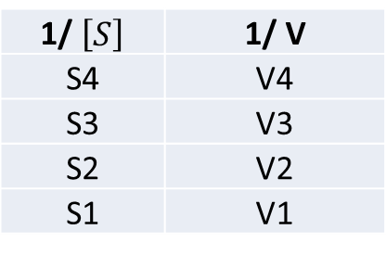
Results: Interpreting
    Lineweaver-Burlee:
$$\frac{1}{V}= \frac{1}{\left[S\right]}\frac{K_{M}}{V_{Max}}+ \frac{1}{V_{Max}}$$
    - From data:
1/ $\left[S\right]$ | 1/ V
S4 | V4
S3 | V3
S2 | V2
S1 | V1
Y $=a x+b$
    Where:
    y = 1/ V a=$\frac{K_{M}}{V_{Max}}$
    X = 1/ S b= $\frac{1}{V_{Max}}$

Slide 15


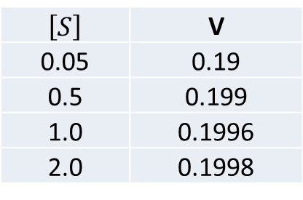


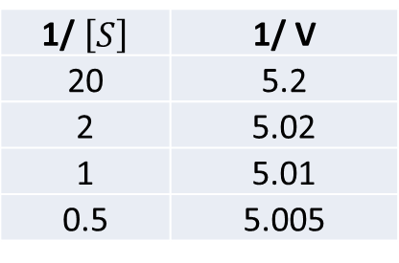
Results: Interpreting
    Example:
$$\frac{1}{V}= \frac{1}{\left[S\right]}\frac{K_{M}}{V_{Max}}+ \frac{1}{V_{Max}}$$
    - From data:
$\left[S\right]$ | V
0.05 | 0.19
0.5 | 0.199
1.0 | 0.1996
2.0 | 0.1998
1/ $\left[S\right]$ | 1/ V
20 | 5.2
2 | 5.02
1 | 5.01
0.5 | 5.005
Y $=0.01 x+5$
$\frac{1}{V_{Max}}$ $=5$
$$VMax=0.2 abs/sec$$
    - From data: choose a concentration from your data: S= 2.0 and V = 0.1998

Slide 16




Results: Interpreting
    - From M-M equation:
$$V= V_{Max} . \frac{\left[S\right]}{K_{M}+\left[S\right]}$$
$$0.1998=0.2 . \frac{2}{K_{M}+2}$$
$$0.1998 KM +0.3996=0.4$$
$$0.1998 KM =0. 0004$$
$$Concentration S where V is$$
$$VMAX/2$$
$$KM =0. 0002$$

Slide 17

Results: Interpreting
    Michaelis-Menten
$$V= V_{Max} . \frac{\left[S\right]}{K_{M}+\left[S\right]}$$
    K_{M} and S : Molarity
    V: abs/ sec
    Large S: Saturation of enzyme
    _{V = Vmax}
    Small S: Slope is V_{max}/K_{M}

Slide 18
Results:
Plot the change in absorbance as a function of time, and determine the slope (this is the initial reaction rate, “v”). You will need to do this for each enzyme concentration and for each ascorbate concentration.
Construct a table showing initial reaction rate “v” as a function of substrate concentration, [S].
Plot initial initial reaction rate “v” as a function of substrate concentration, [S] (this is the Michaelis-Menten plot). Briefly discuss your observations.
From the Michaelis-Menten plot, estimate Km and Vmax.
Construct a table showing initial reaction rate “v” as a function of ascorbate concentration.
Plot initial reaction rate “v” as a function of ascorbate concentration. Briefly discuss your observations.

Slide 19
Visual observations:
“Experiment” with the browning reactions and record your observations.
Choose factors that you believe will influence the
  rate of the reaction
  severity of browning
  reversibility of the browning
  timing of the reaction
  timing of reversibility of color

Slide 20
Visual observations:
  Expect to conduct MANY different observational trials, using about 10 mL of solution for each.
  Take your time and record all observations.
  You are on your own, so the more data you collect the better the discussion you can write.
  THINK about what you are doing before you do it. Create a hypothesis and experimentally test it.

Slide 21
Tool Box:
A beaker and stir-bar for mixing.
Buffers to control pH
Hydrochloric acid solution to modify pH
Citric acid to modify pH and act as a metal chelator
Phosphates to act as metal chelators
Hydrogen peroxide as an oxygen source
A hot plate to provide heat
Ice to provide cold
Ascorbic acid and/or sodium sulfite (inhibitor)
Bentonite clay, as a protein binding agent
Sodium Borate (Borax) (inhibitor)

