Slide 1
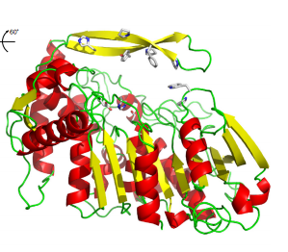
Enzymes in the Food Industry
Food Chemistry Lab (FSTC 313)
Figure. Stucture of tannase from Lactobacillus plantarum. Retrieved from Ren, B. et al. Crystal structure of Tannase from Lactobacillus plantarum. 2013. Journal of Molecular Biology, 425, 2737-2751.

Slide 2
Outline
Enzyme Basics
- Definitions
- Factors to Consider
Enzymes in Food Processing
Enzymes and Food Quality
Expectations for Lab #5 (Today) and Protein Lab Reports

Slide 3
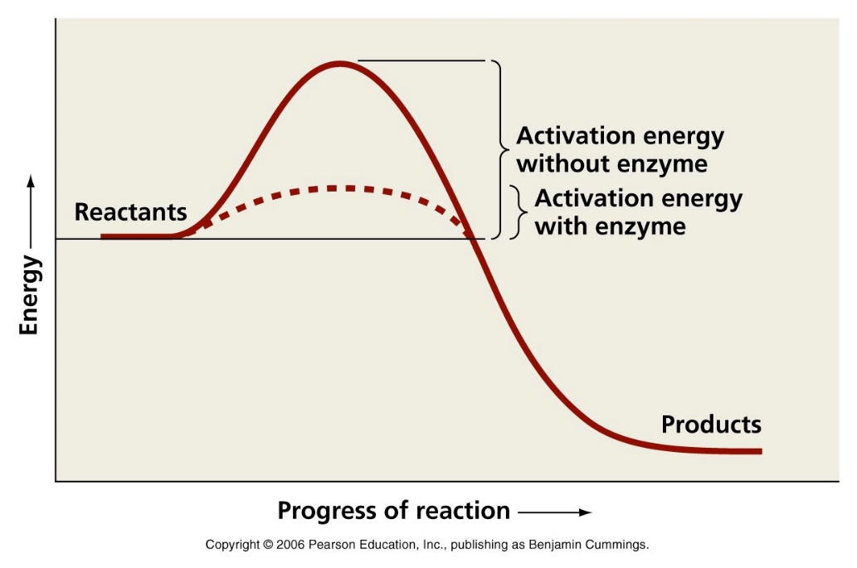
What are Enzymes?
Proteins that catalyze chemical reactions by lowering the activation energy
In other words…they make reactions go faster!

Slide 4
Factors to Consider with Enzymes
pH
Temperature
Concentration Substrate and Enzyme
Specificity
Cofactors and Inhibitors

Slide 5
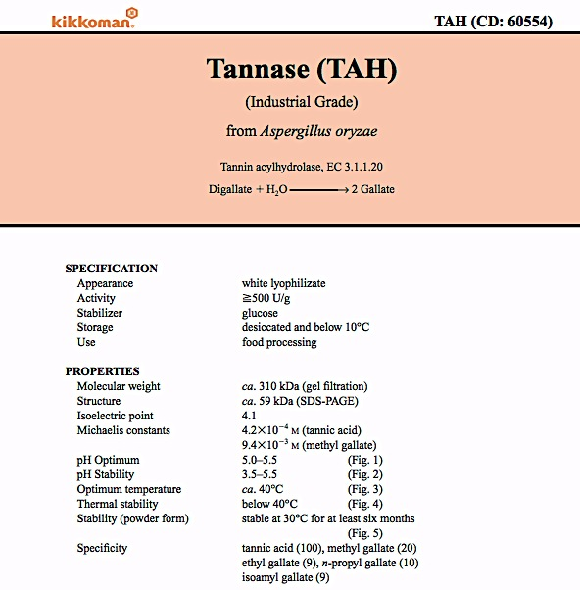
Example of Enzyme Info Sheet

Slide 6
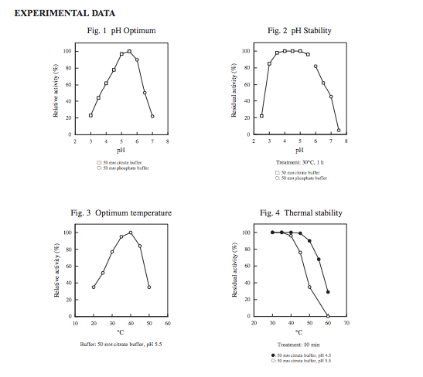
Example of Enzyme Info Sheet

Slide 7
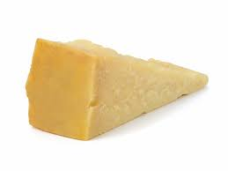
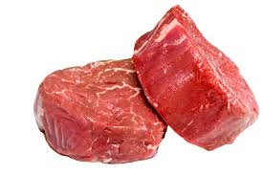
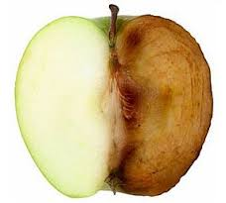
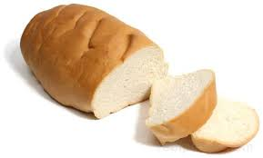
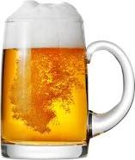
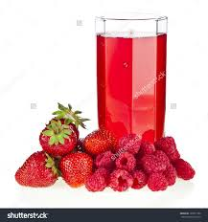
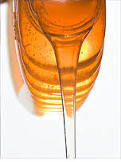
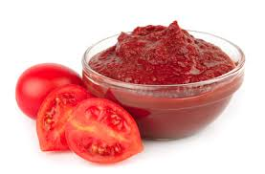
How do enzymes effect these food products?

Slide 8
Food | Enzymes
Bread | Glucose Oxidase
Meat | Papain Bromelain
Cheese | Chymosin
Browned Apple | Polyphenol Oxidase
Beer | Amylase Protease
Juice | Pectinase Cellulase Hemicellulase
HFCS | Amylase Pullulanase Glucose Isomerase
Tomato Paste | Polygalacturonase Pectin Methyl Esterase

Slide 9
Enzymes in Food Processing
Enzymes are used to improve food quality (Meat, Juice)
Enzymes are used to speed up/control the production process (HFCS, Bread, Cheese)
Natural enzymes from the raw material are manipulated during processing (Beer, Tomato Paste)
Enzymes cause food quality issues (Citrus, Browned apples)

Slide 10
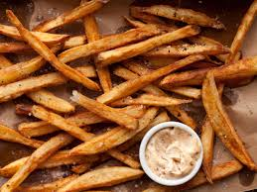
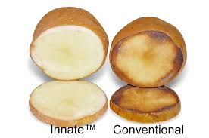
Browning
Browning can be either desirable (caramel, bread crust) or undesirable (fruit and vegetables)
Browning can be characterized as non-enzymatic (maillard, ascorbic acid) and enzymatic
Polyphenol oxidase (PPO) is the major culprit of enzymatic browning in foods
Maillard (non-enzymatic)
PPO (enzymatic)

Slide 11
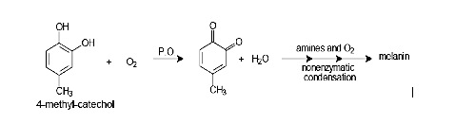
How PPO Works

Slide 12
INTRODUCTION
Browning:
      Fruits and vegetables
Enzymatic
Non-enzymatic
Sensory properties
- Color
- Flavor
Oxidation of phenolic compounds
Bad
Good

Slide 13
INTRODUCTION: PPO
Polyphenoloxidase (PPO): Enzyme that catalyze browning reaction
  Examples: Apples, avocados, lettuce, potatoes
The reaction:
Cu⁺
Quinones
Soluble or Insoluble brown polymers

Slide 14
INTRODUCTION
What factors determine rate of enzymatic browning?
  Concentration of available PPO
  Concentration of Phenolics
  pH
  Temperature
  Oxygen availability

Slide 15
INTRODUCTION
How can we control the reaction?
  Ascorbates, bisulfites, thiols --- Reducing agents, Reduce quinone formation
  EDTA, Oxalic acid, Citric Acid --- Chelators
  Citric acid, malic, phosphoric acids --- Change pH of solution

Slide 16
Questions to get you thinking…
Are there any foods where browning by PPO is desirable?
Are all PPOs the same? For example, if I were to isolate PPO from 2 different vegetables would I get the same protein?
Knowing what we know about enzymes and proteins, how can we inhibit their activity?
Is it possible to stop this reaction without inhibiting the enzyme?

Slide 17
OBJECTIVES
    To measure enzymatic activity and determine concentration dependence of an enzyme-catayzed reaction rate on substrate concentration
    Evaluate influence of inhibitors

Slide 18
MATERIAL
    Potato filtrate
    Substrate: 20mM catechol dissolved in buffer
    5mM ascorbic acid dissolved in buffer

Slide 19
Method 2: Impact of Inhibitor
    Effect of Ascorbic acid on PPO activity
    Each group will assay phenol oxidase activity in the presence of various concentrations of ascorbic acid, in duplicate
Material | Volume needed (mL)
Catechol (mL) | 2.00 | 2.00 |  | 2.00 |  | 2.00
Phosphate buffer (mL) | 0.90 | 0.88 |  | 0.82 |  | 0.58
Inhibitor (mL): | 0.00 | 0.02 |  | 0.08 |  | 0.32
Potato filtrate | 0.10 | 0.10 |  | 0.10 |  | 0.10
Total volume (mL) | 3.00 | 3.00 |  | 3.00 |  | 3.00
Lab Group #
    Observe browning based on scale of 1-10 visual rating

Slide 20

Results: Interpreting
    Plot the change in absorbance as a function of time, and determine the slope:
$\left[E\right]$+ $\left[S\right]$ $\left[ES\right]$ $\left[E\right]$ + $\left[P\right]$
SLOPES:
- Abs/time
SLOPES =
Rate
Velocity

Slide 21
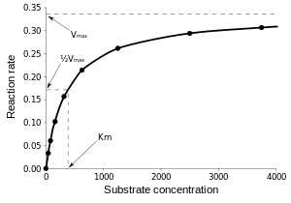


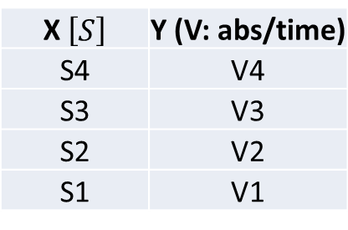
Results: Interpreting
Slopes = Velocity – Plot a graph:
X $\left[S\right]$ | Y (V: abs/time)
S4 | V4
S3 | V3
S2 | V2
S1 | V1
    Michaelis-Menten
$$V= V_{Max} . \frac{\left[S\right]}{K_{M}+\left[S\right]}$$
    Linearize
$$\frac{1}{V}= \frac{1}{\left[S\right]}\frac{K_{M}}{V_{Max}}+\frac{1}{V_{Max}}$$

Slide 22
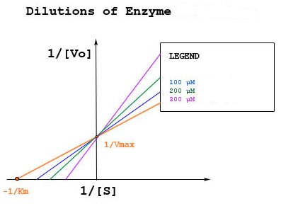
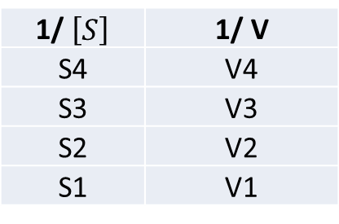
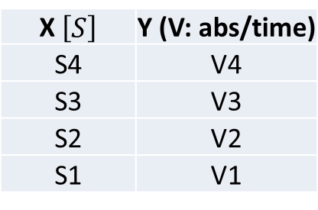

Results: Interpreting
How can we work with this data?
X $\left[S\right]$ | Y (V: abs/time)
S4 | V4
S3 | V3
S2 | V2
S1 | V1
1/ $\left[S\right]$ | 1/ V
S4 | V4
S3 | V3
S2 | V2
S1 | V1
    Michaelis-Menten
    Lineweaver-Burlee
$$\frac{1}{V}= \frac{1}{\left[S\right]}\frac{K_{M}}{V_{Max}}+ \frac{1}{V_{Max}}$$

Slide 23



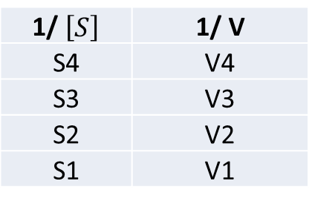
Results: Interpreting
    Lineweaver-Burlee:
$$\frac{1}{V}= \frac{1}{\left[S\right]}\frac{K_{M}}{V_{Max}}+ \frac{1}{V_{Max}}$$
    - From data:
1/ $\left[S\right]$ | 1/ V
S4 | V4
S3 | V3
S2 | V2
S1 | V1
Y $=a x+b$
    Where:
    y = 1/ V a=$\frac{K_{M}}{V_{Max}}$
    X = 1/ S b= $\frac{1}{V_{Max}}$

Slide 24


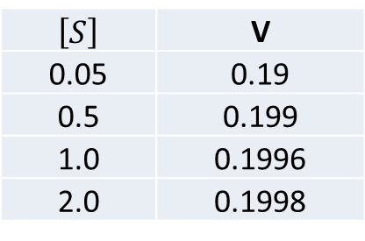


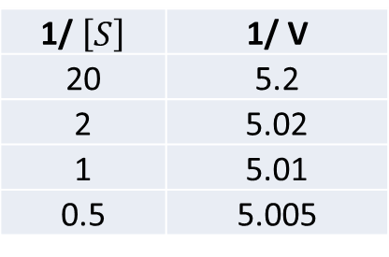
Results: Interpreting
    Example:
$$\frac{1}{V}= \frac{1}{\left[S\right]}\frac{K_{M}}{V_{Max}}+ \frac{1}{V_{Max}}$$
    - From data:
$\left[S\right]$ | V
0.05 | 0.19
0.5 | 0.199
1.0 | 0.1996
2.0 | 0.1998
1/ $\left[S\right]$ | 1/ V
20 | 5.2
2 | 5.02
1 | 5.01
0.5 | 5.005
Y $=0.01 x+5$
$\frac{1}{V_{Max}}$ $=5$
$$VMax=0.2 abs/sec$$
    - From data: choose a concentration from your data: S= 2.0 and V = 0.1998

Slide 25




Results: Interpreting
    - From M-M equation:
$$V= V_{Max} . \frac{\left[S\right]}{K_{M}+\left[S\right]}$$
$$0.1998=0.2 . \frac{2}{K_{M}+2}$$
$$0.1998 KM +0.3996=0.4$$
$$0.1998 KM =0. 0004$$
$$Concentration S where V is$$
$$VMAX/2$$
$$KM =0. 0002$$

Slide 26

Results: Interpreting
    Michaelis-Menten
$$V= V_{Max} . \frac{\left[S\right]}{K_{M}+\left[S\right]}$$
    K_{M} and S : Molarity
    V: abs/ sec
    Large S: Saturation of enzyme
    _{V = Vmax}
    Small S: Slope is V_{max}/K_{M}

Slide 27
Visual observations:
“Experiment” with the browning reactions and record your observations.
Choose factors that you believe will influence the
  rate of the reaction
  severity of browning
  reversibility of the browning
  timing of the reaction
  timing of reversibility of color

Slide 28
Visual observations:
  Expect to conduct MANY different observational trials, using about 10 mL of solution for each.
  Take your time and record all observations.
  You are on your own, so the more data you collect the better the discussion you can write.
  THINK about what you are doing before you do it. Create a hypothesis and experimentally test it.

Slide 29
Experimental Screening
Apples
Citric Acid
Hydrogen Peroxide
Sodium Sulfite
Ascorbic Acid
NaOH
HCl
Potatoes
Citric Acid
Hydrogen Peroxide
Sodium Sulfite
Ascorbic Acid
HCl
NaOH

Slide 30
Practical Trails
Place Catechol solution on potato and apples, let sit for 10 minutes
Take the solutions that helped inhibit browning in previous traiIs and treat potatoes and apples with 0.5 mL
Record observations

Slide 31
Practical Trails
Compare apples/potatoes that were sitting out to apples/potatoes that were in an ice water bath
Cut the apples and potatoes into smaller pieces and observe the effect
Observe if leaving the potatoes and apples out for longer periods of times prevents inhibition of browning

Slide 32
Materials
Citric Acid – Chelator, organic/weak acid
HCl – strong acid
NaOH – strong base
Hydrogen peroxide – pro-oxidant
Sodium sulfite – reducing agent
Ascorbic acid – reducing agent
Catechol – polyphenol
Potato/apples – source of PPO

Slide 33
Tool Box:
A beaker and stir-bar for mixing.
Buffers to control pH
Hydrochloric acid solution to modify pH
Citric acid to modify pH and act as a metal chelator
Phosphates to act as metal chelators
Hydrogen peroxide as an oxygen source
A hot plate to provide heat
Ice to provide cold
Ascorbic acid and/or sodium sulfite (inhibitor)
Bentonite clay, as a protein binding agent
Sodium Borate (Borax) (inhibitor)

