Slide 1
Milk Proteins
Effect of pH and Ionic Strength on Solubility of Proteins

Slide 2
INTRODUCTION
Food Industry:
- Functional Properties - Nutritional
Gelation
Foaming
Change in viscosity
Examples:
Whole eggs, egg yolk, egg albumen, whey solids, non-fat dry milk

Slide 3
Types of Proteins
Isolates: 90-95% protein by weight
Concentrates: 50-70%
Methods:
Differences in solubility – function of pH and ionic strength of environment
Purification – size exclusion techniques (ultrafiltration)
Chromatographic approaches - particle size
- density
- Charges
- polarity

Slide 4
Influences of pH on solubility
Due to overall charges:
- NH₂
COOH
Groups on side chain
In order words:
Positively charged: ------------ At Low pH
Negatively charged: ------------- At high pH
ISOELECTRIC POINT OF A PROTEIN: Intermediate pH at which the net charge zero

Slide 5
Influences of pH on solubility
Interaction with water:
Either positive or negatively charged
Soluble
At isoelectric point: ???

Slide 6
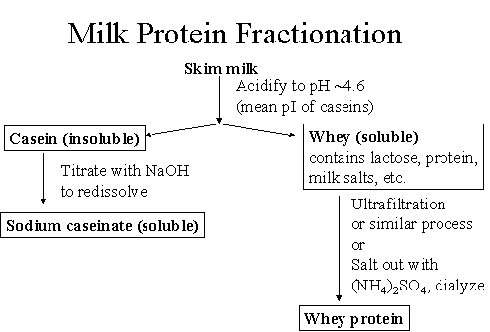
Milk Proteins
Isoelectric point of Casein
Remaining proteins: May be precipitated with salts

Slide 7
“Salting out”
Salting Out: Proteins have unique solubility profiles in neutral salt solutions.
Low concentrations of neutral salts may:
Increase the solubility of some proteins
Precipitate from solution as ionic strength is increased.
Actions are somewhat unique to each protein.
Ammonium sulfate (NH₄)₂SO₄ is commonly used because it is highly soluble and very effective.
NaCl or KCl may be also be used to “salt out” proteins.

Slide 8
“Salting out”
Ionic Strength = ½ Σ M_{i}Z_{i}²
M_{i} = Molarity of ion
Z_{i} = Charge of ion
1M NaCl = ½ Σ (1 X 1²) + (1 X 1²)= 1
1M CaCl₂ = ½ Σ (1 X 2²) + (2 X 1²) = 3
1M (NH₄)₂SO₄ ₌ ½ Σ (2 X 1²) + (1 X 2²) = 3
Na⁺
Cl⁻
Ca²⁺
Cl⁻
NH₄⁺
SO₄²⁻

Slide 9
Objectives of Lab:
To illustrate the effects of pH on protein solubility.
To provide a better understanding of the isoelectric point of a protein.
To examine the influence of salt addition on protein solubility.

Slide 10
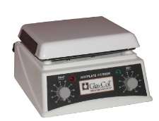
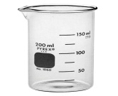
Procedure - Casein
Heat to 40°C
pH 4.6
(1.0M HCl)
1.
Weigh 50mL of Skim milk
Adjust pH with 1.0M HCl (to 4.4 to 4.6)
2.
Weigh a 50mL falcon tube – Register
3.
Pour whey into a beaker: Save it!!!
Retain insoluble proteins in tube.
Heat to 40°C
Separated Casein from whey: add to falcon tube
Centrifuge it for 10 minutes
4.
Casein: Re-weigh solids in tube. Add to original beaker: Calculate amount of hydrated casein
Centrifuge
10 Min
Casein
Whey (soluble)
Weigh
Calculate hydrated casein

Slide 11
Procedure
Add 50mL to casein curds
5.
Suspend the casein curd in 50mL of water.
6.
Register observations
SLOWLY and DROP WISE add 1.0M NaOH until pH 7.5, STIR CONSTANTLY
pH 7.5
1.0 NaOH
CONTINUOUS STIR!!!!

Slide 12
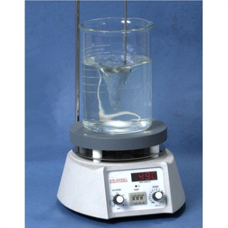
Procedure - Whey
7.
Weigh 30g Ammoniun sulfate
8.
Weigh falcon tube (50mL)
Add whey protein and centrifuge for 5min
Slowly add the rest of the Ammonium sulfate to the whey (stirring for 5min) and repeat centrifugation
Shake well and add whey back to beaker
9.
Pour off supernatant and weigh the residual protein precipitate.
Add half NH4SO4 slowly to Whey– with magnetic stirrer
constant stirr for 5min: To salt out of proteins
Take Whey proteins (pH 4.6, approximately 50mL)
Add ½ NH₄SO₄ SLOWLY
Centrifuge
5 Min
Supernatant
Discuss your observations

Slide 13
Results:
Calculate the protein yield of casein and whey proteins and compare your yields with values reported in the literature. Do your values agree or disagree with those in the literature? Why or why not (keep in mind that you have hydrated proteins, not dried proteins).
Define the concept of “isoelectric point”. According to your results, what is the isoelectric point of casein? What happened to casein at higher pHs?
What is “salting out”?, why did we choose to “salt out” the whey proteins instead of just adjusting the pH?

Slide 14
Discussion: Project
You just took a job with Protein USA, a major supplier of all forms of protein to the food industry. Your supervisor assigns you to a project for Nestle USA, one of the world’s largest food companies, and their most important customer.
Nestle is developing a new variety of Lean Cuisine entrees, targeted to vegetarian consumers, and are interested on using soy as the major protein source and are thinking about buying from your company.
However, your Nestle customers want to know more about the basic principles behind the soy protein isolation process, the major functional properties of your protein isolate, and their potential applications (eg. meat replacers, textured foods).

