Slide 1
Starch and Carbohydrates
Properties of Starches and Gums

Slide 2
INTRODUCTION
Energy storage for plants and animals
Food Industry:
Thickening or gelling agents:
Expand or make food systems smaller
Give opacity or transparency
Retain moisture or repel it
Help emulsions

Slide 3
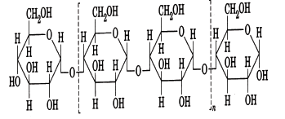
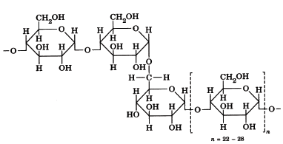
Characteristics of Starches
Amylose
Amylopectin

Slide 4
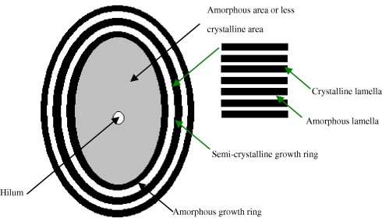
Characteristics of Starches
Amylose
Amylopectin
Found in Amorphous region
Upon Heating - leached out allowing
water to enter and swell the starch granule in the crystalline region
Found in Crystalline region
Highly influences on viscosity changes due to water and heating (gelatinization)

Slide 5
Important Processes
Gelatinization
Swelling of starch granules due to water and heat
Gelatinization temperature: the temp at which Max. viscosity is reached.
Retrodegradation
At cooling, re-association of hydrogen bonds between the molecules of amylose that are leached out.
Increase in amylose content in starch – leads to Increased in viscosity

Slide 6
Factors Effecting Starch Gelatinization
Starch Composition (Ratio of Amylose to Amylopectin)
Botanical Source (i.e. Potato vs Corn)
pH
Rate of Shear
Modifications (Chemical and Physical)

Slide 7
Objective
To investigate the factors that affects the thickness of a cooked starch paste and to compare the usefulness of various starches (i.e. normal, waxy, and modified).

Slide 8
Lab
1st Part: Gelatinization and Retrodegradation properties of starches
Select up to 3 Starches (0.25 to 0.5 grams each)
Add water: about 80% of test tube
SLOWLY Begin heating the water: OBSERVE
Shake as temperature increases: don’t be shy!!!!
Record your observations!!! (as temperature changes)
Solubility, color, texture
Record GTR: temperature range at which starch starts swelling until the last bit has gelatinized.
Cool starches and observe changes in viscosity or gel strength
Record your observations!!!

Slide 9
Lab
2nd Part: Modification of Starch Gelatinization
Select your Starch and place into separate beakers (1 g)
Add your respective modification
Mix all at once: Mix it good!!!!
Bring to a constant volume (~50 mL) with water
Place them on the heat plate and slowly heat until gelatinization temp is reached.
Record your observations!!!
Solubility, color, texture
Don’t overheat starch!!! Take your time in heating…Stir
Add more water as needed, keep constant
Record your observations!!!

Slide 10
Lab
2nd Part:
Cool the samples as best you can (cold water / fridge)
Pour a uniform amount in a beaker and cool in cold water
Determine viscosity – LINE SPREAD TEST
LINE SPREAD TEST:
Fill sample cup to top, leveling it off.
Dump onto the line-spread circles – over the plastic lid.
Allow to spread for 2 minutes.
Read nearest line on all four sides.

Slide 11
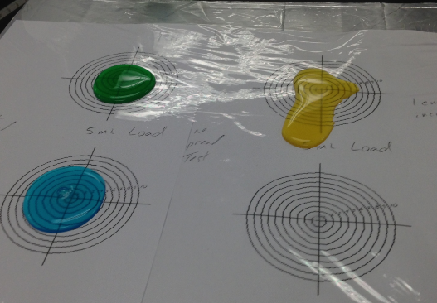
Line Spread Test

Slide 12
Lab Results
Which starches would be suitable for thickening a sauce or gravy? For a cherry pie? For a cream pie? A soup? Etc. Explain your answers.
Why is the GTR and the time it takes to gelatinize an important factor? Explain.
What effect does the addition of sugar, oil, and acid have on the gelatinization of starch? Why is this important for the food industry? Explain.

Slide 13
Organization of lab
Starch Modifications (Wheat):
Lab Group # | Modifications
1 | Sucrose = 0, 5 and 10 grams
2 | Oil = 0, 2 and 5 mL
3 | Citric Acid = 0, 3 and 6 grams
4 | Sucrose + Citric Acid = 0+0, 5+3 and 10+3 grams
5 | Oil + Citric Acid = 0+0, 2+2 and 5+2 grams
What else can you do?
What would you like to try?

Slide 14
Discussion
Which starches would be suitable for thickening a white sauce or gravy? For a cherry pie? For a cream pie? Etc. Explain your answers.
Why is the GTR and the time it takes to gelatinize an important factor? Explain.
What effect does the addition of sugar, oil, and acid have on the gelatinization of starch? Why is this important for the food industry? Explain.

