Slide 1
Sucrose Hydrolysis
Non-Enzymatic (Acid Hydrolysis)
Versus
Enzymatic Hydrolysis (Sucrase/Invertase)

Slide 2
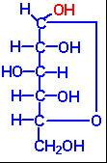
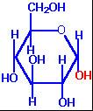
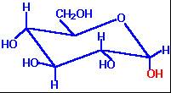
Fischer Projection of a-D-Glucose
Reducing End of
Glucose/Fructose
Haworth Projection of a-D-Glucose
Chair form of a-D-Glucose

Slide 3
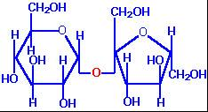
Disaccharides
Bonds between sugar units are termed glycosidic bonds, and the resultant molecules are glycosides.
The linkage of two monosaccharides to form disaccharides involves a glycosidic bond. The important food disaccharides are sucrose, lactose, and maltose.
No reducing capacity
Reducing ends are not
exposed due to 1,2 bond
Sucrose: prevalent in sugar cane and sugar beets, is composed of glucose and fructose through an α-(1,2) glycosidic bond.

Slide 4
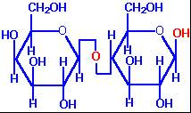
Both are reducing sugars…so we could do this in milk
Lactose:
is found exclusively in the milk of mammals and consists of
galactose and glucose in a β-(1,4) glycosidic bond.

Slide 5
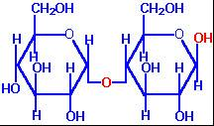
…and in starch hydrolysis reactions to monitor
glucose production in making corn syrup!
Maltose:
Is the major degradation product of starch, and is composed
of 2 glucose monomers in an α-(1,4) glycosidic bond.

Slide 6
Chemical Properties of Reducing Sugars
Reducing Sugars
Some monosaccharides can act as Reducing Agents (electron donators). (I.e. Glucose and Fructose)
They reduce Fehling’s, Tollen’s, or Folin’s Reagents
We will use these properties of sugars for understanding their physical properties.

Slide 7
Examples of Reducing Sugars and Non-Reducing Sugars
REDUCING
D-glucose
D-fructose
Galactose
Maltose
Maltotriose
NON-REDUCING
Sucrose
Raffinose
Cellulose
Amylopectin
Larger dextrins

Slide 8
Chemical Methods (Spectrophotometric)
Simple “phenols” will react with reducing sugars under the right pH and temperature conditions to product a colored “chromaphore” that can be read on a spectrophotometer.
Refer to your “Food Analysis” course.

Slide 9
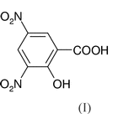
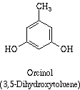
Chemical Methods
3,5-DINITROSALICYLIC ACID reacts with reducing sugars in alkali to form brown-red color that can be measured on a spec
RESORCINOL (a phenol) reaction is primarily with ketoses to form a colored complex
ORCINOL (a phenol) reacts with pentoses with 5X more color than hexoses

Slide 10
To the “extreme”
Some methods detect the reaction of “going toooo far” with the sugar hydrolysis
PHENOL mixed with SULFURIC ACID and heated with “digest” carbohydrates to create furans (furfural, 5-hydroxymethyl furfural, furaldehyde) which condenses with phenol into a near pink color.

Slide 11
Going Tooo Far
In today’s lab, we want to optimally hydrolyze sucrose.
The goal is to get the MOST glucose and fructose possible (competition?)
Too gentle, and no reducing sugar is created
Too harsh, and you will break-down your reducing sugars into aldehydes.
Aldehydes will not react with 3,5-DNSA

Slide 12
Beer’s Law: States that as absorbance
increases, so does concentration
A = εbc or just A = abc
A = absorbance
ε = extinction coefficient
b = light path distance
c = concentration
We are using a standard curve, generated from pure glucose, so:
A = C
When using 200µL of reactant in a microplate.

Slide 13
Maximum Level of Beers Law Actual Cutoff is Dependent on the Given Assay
Stay within a linear range…..too much reducing sugar and you can not get an accurate reading (may need to dilute your sample more)

Slide 14
Glucose Standard Curve
The slope of your standard curve is: 0.00051
Abs
Concentration (mg/L or ppm)

Slide 15
Case Study: Hydrolysis in Orange Juice
Sucrose hydrolysis occurs quite frequently in OJ.
Sucrose inverts or hydrolyzes to form 1 molecule of glucose and 1 of fructose from the heat of processing and natural organic acids.
Results in changes to sweetness and degradation
Fructose and glucose are then succeptable to degradation (HMF formation).
HMF results in brown color formation, a smelly aroma, and a bitter/medicinal taste.
Based on your lab group’s data, how easy/hard would it be for OJ to have inverted sucrose and/or reducing sugar degradation?

Slide 16
Today’s Lab Details
Everybody run trials for 0, 15, 30, 45, and 60 mins
Group | Acid | Temp °C |  | Group | Enzyme | Temp °C
1 | L, H | 40 |  | 8 | L, H | 40
2 | L, H | 50 |  | 9 | L, H | 50
3 | L, H | 60 |  | 10 | L, H | 60
4 | L, H | 70 |  | 11 | L, H | 70
5 | L, H | 50 |  | 12 | L, H | 50
6 | L, H | 60 |  | 13 | L, H | 60
7 | L, H | 70 |  | 14 | L, H | 70
Get your water-bath going and regulated ASAP !!!!

